Slide 1
Presentation
Grace Cheung

Slide 2
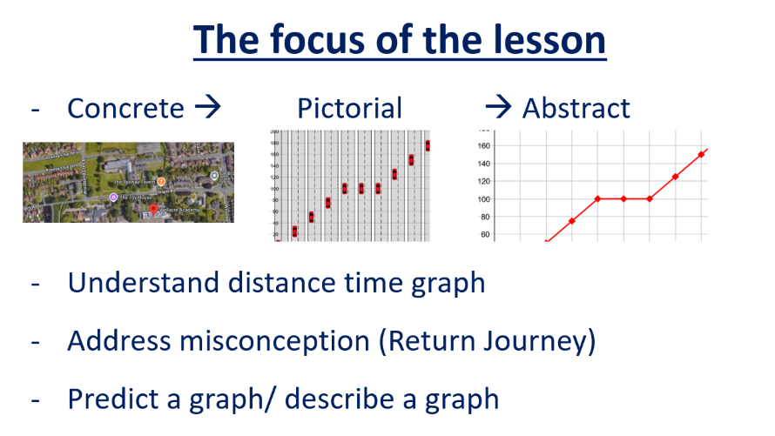
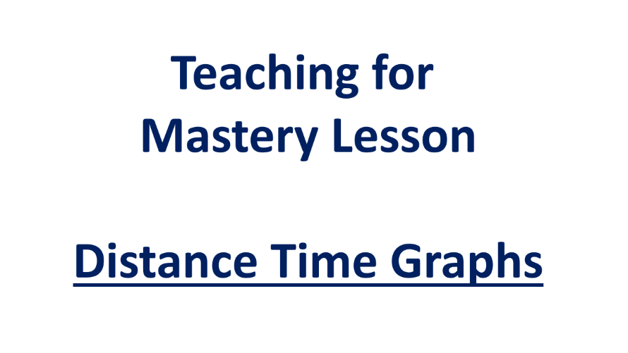
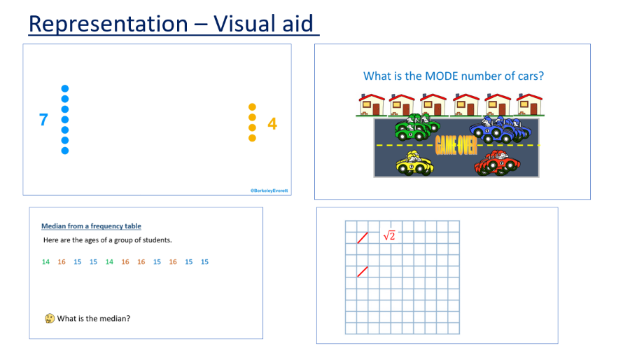
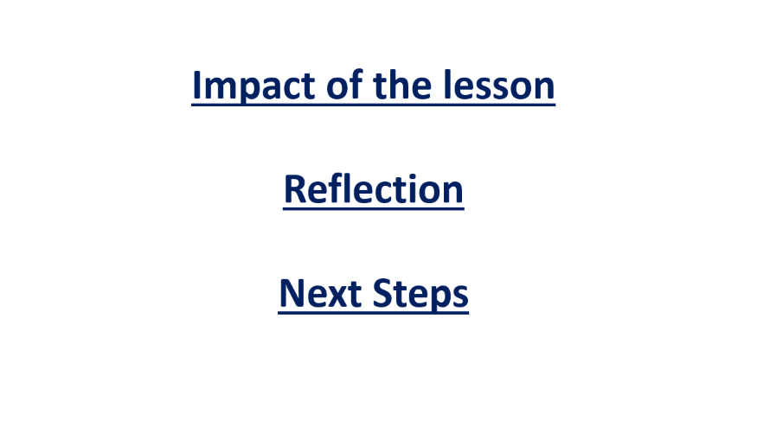

Slide 3
Teaching for
Mastery Lesson
Distance Time Graphs

Slide 4
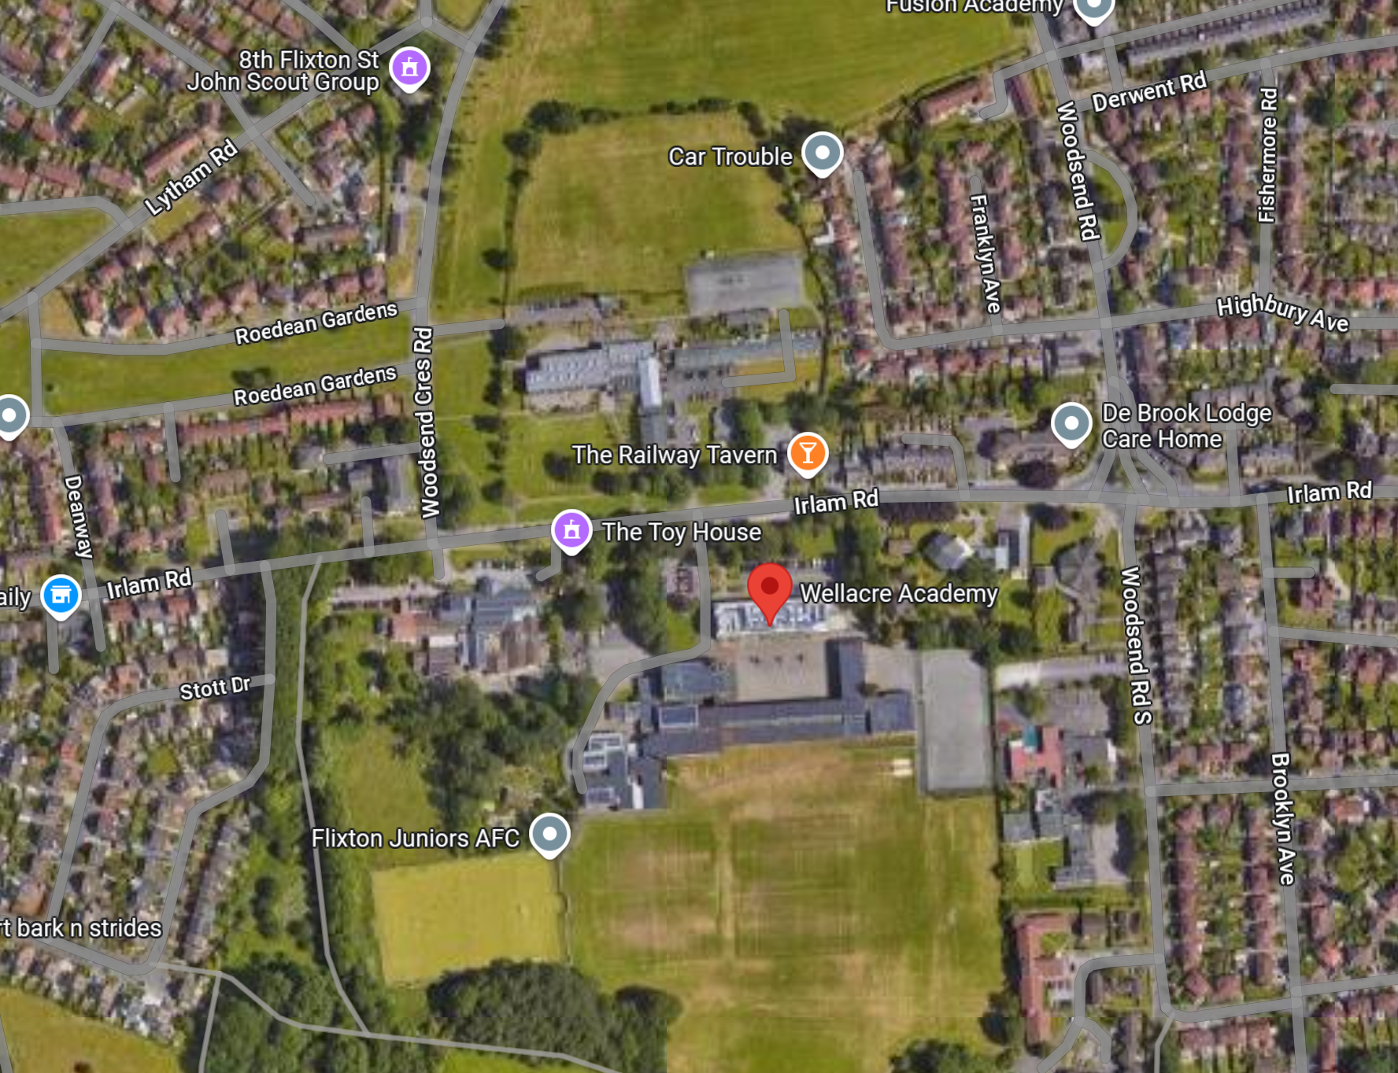

Slide 5
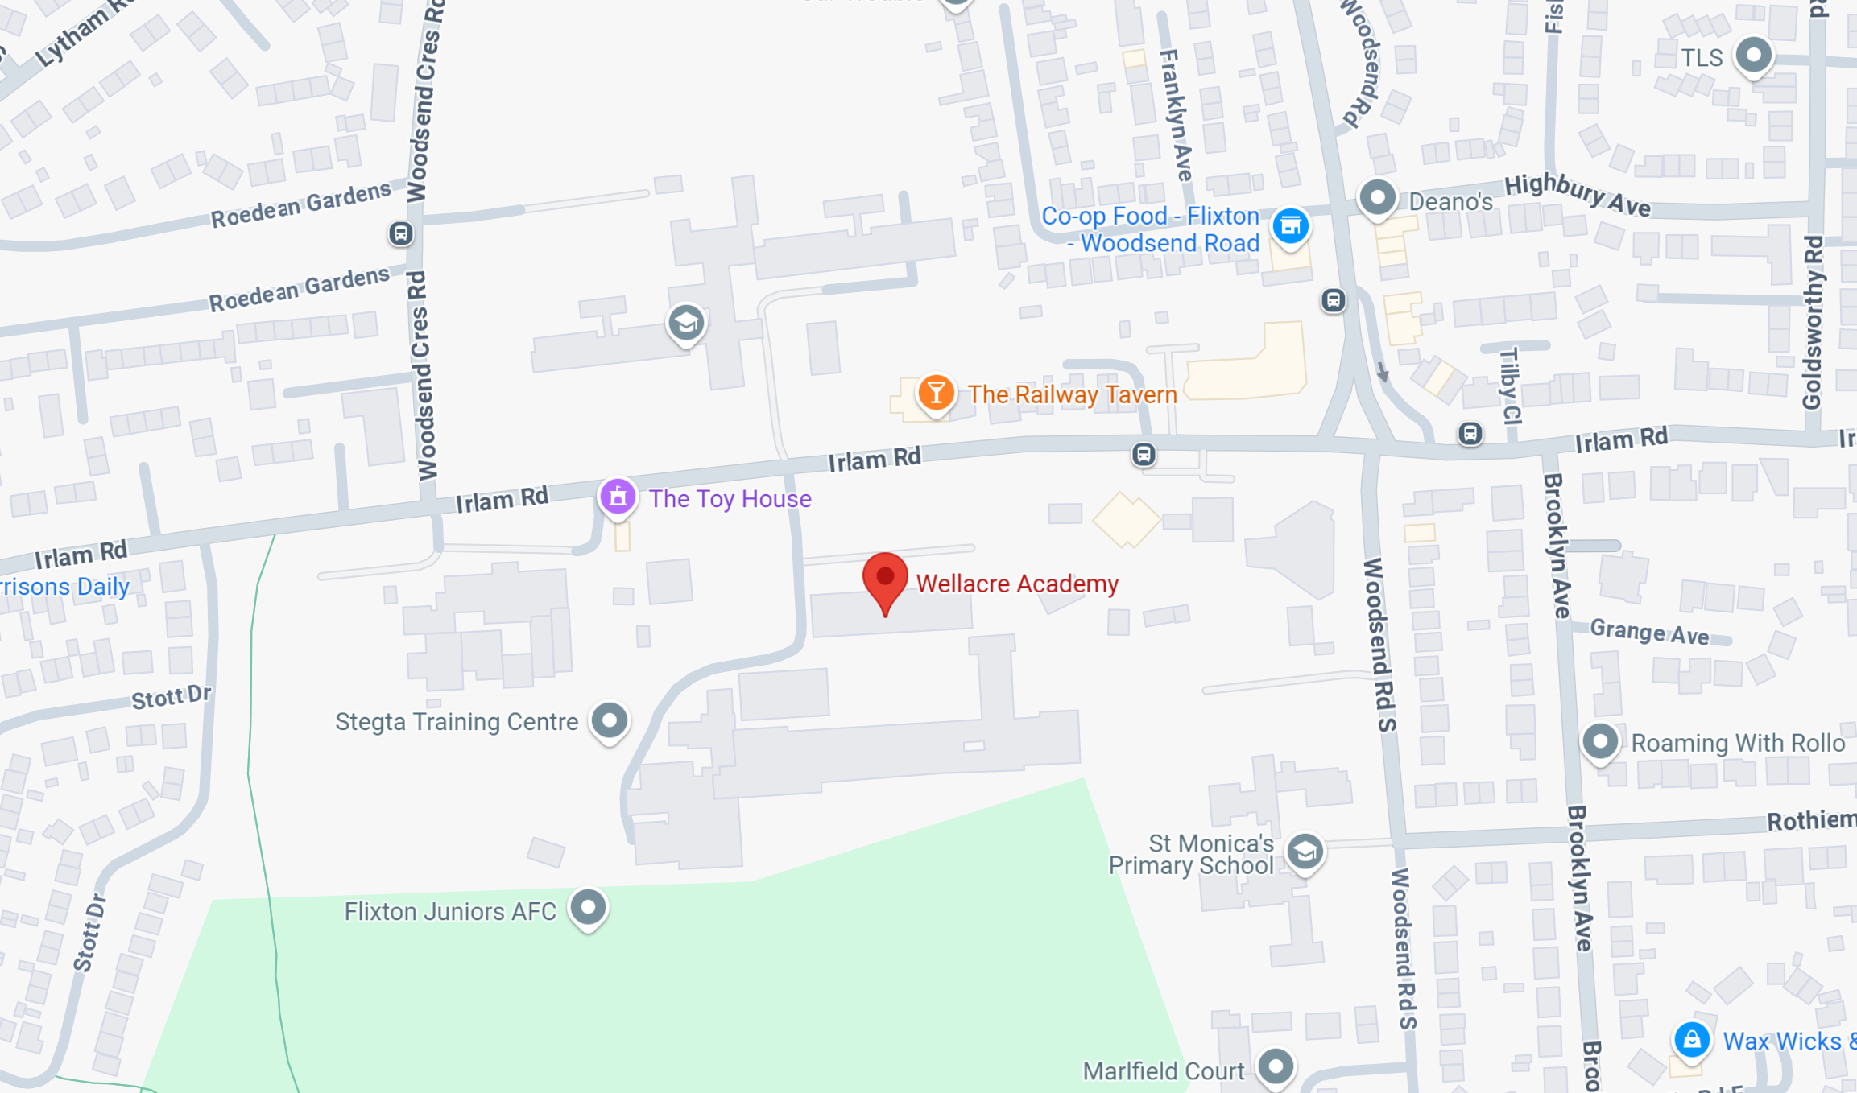

Slide 8
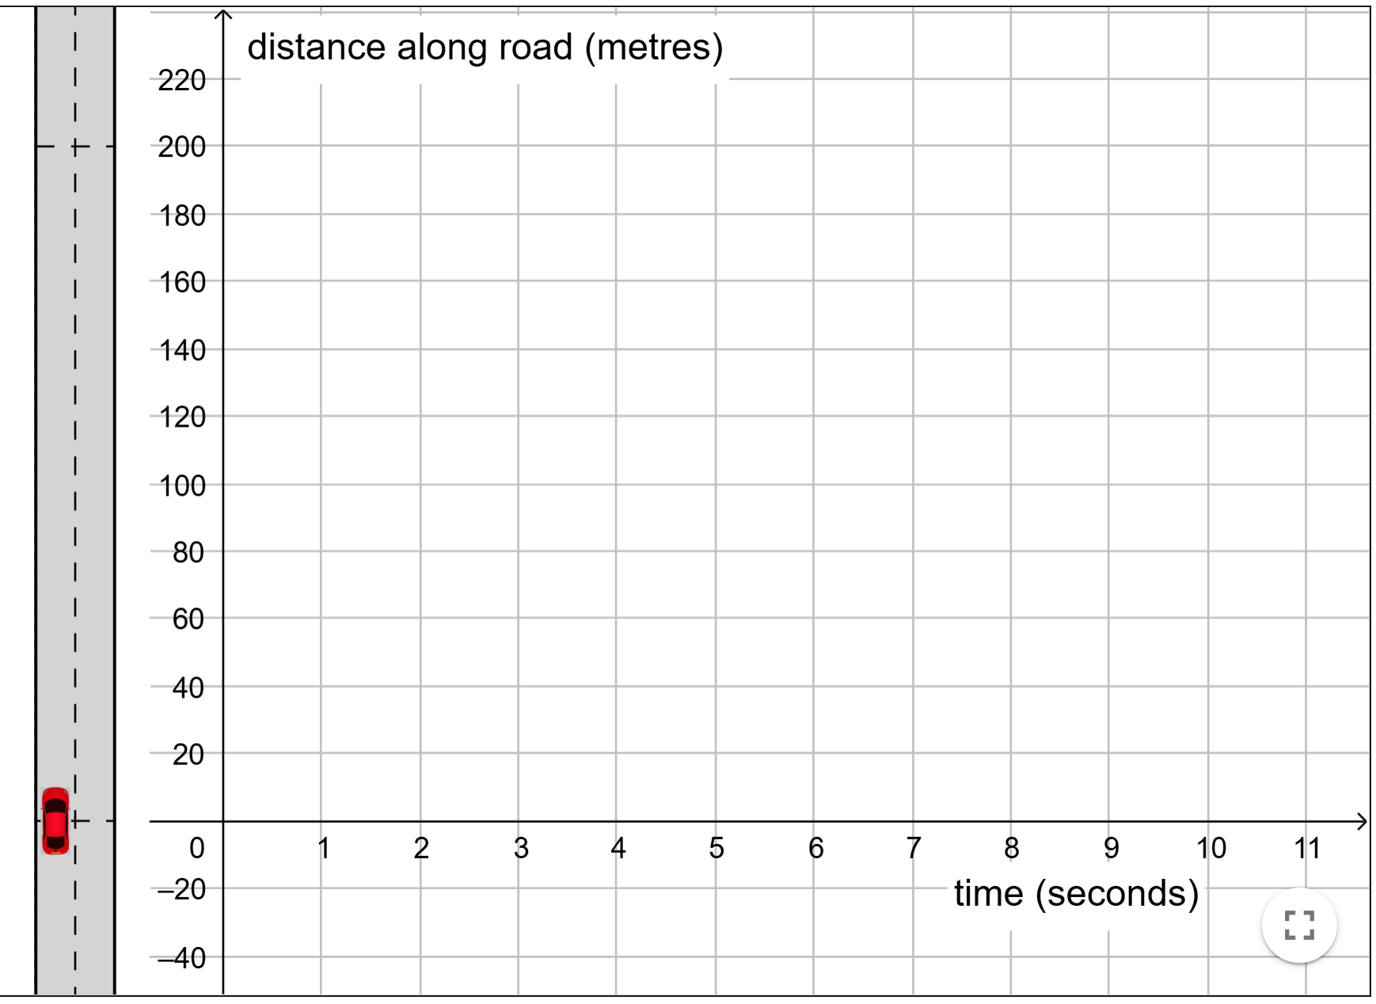

Slide 9
V1

Slide 10
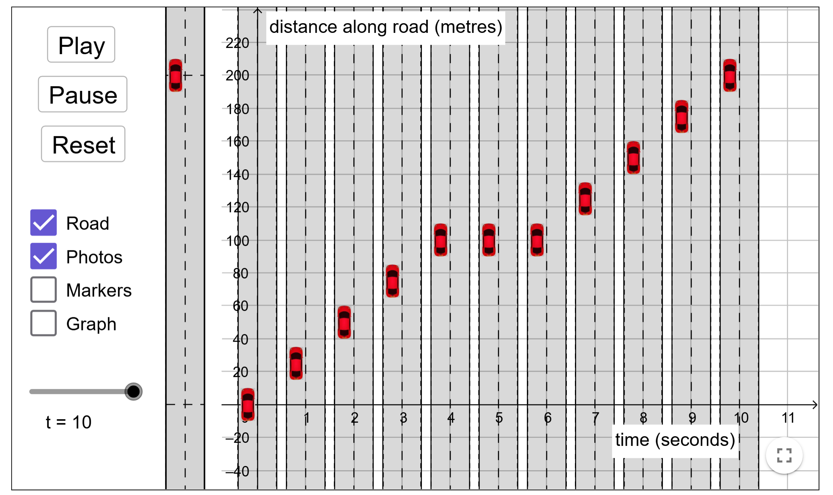

Slide 11
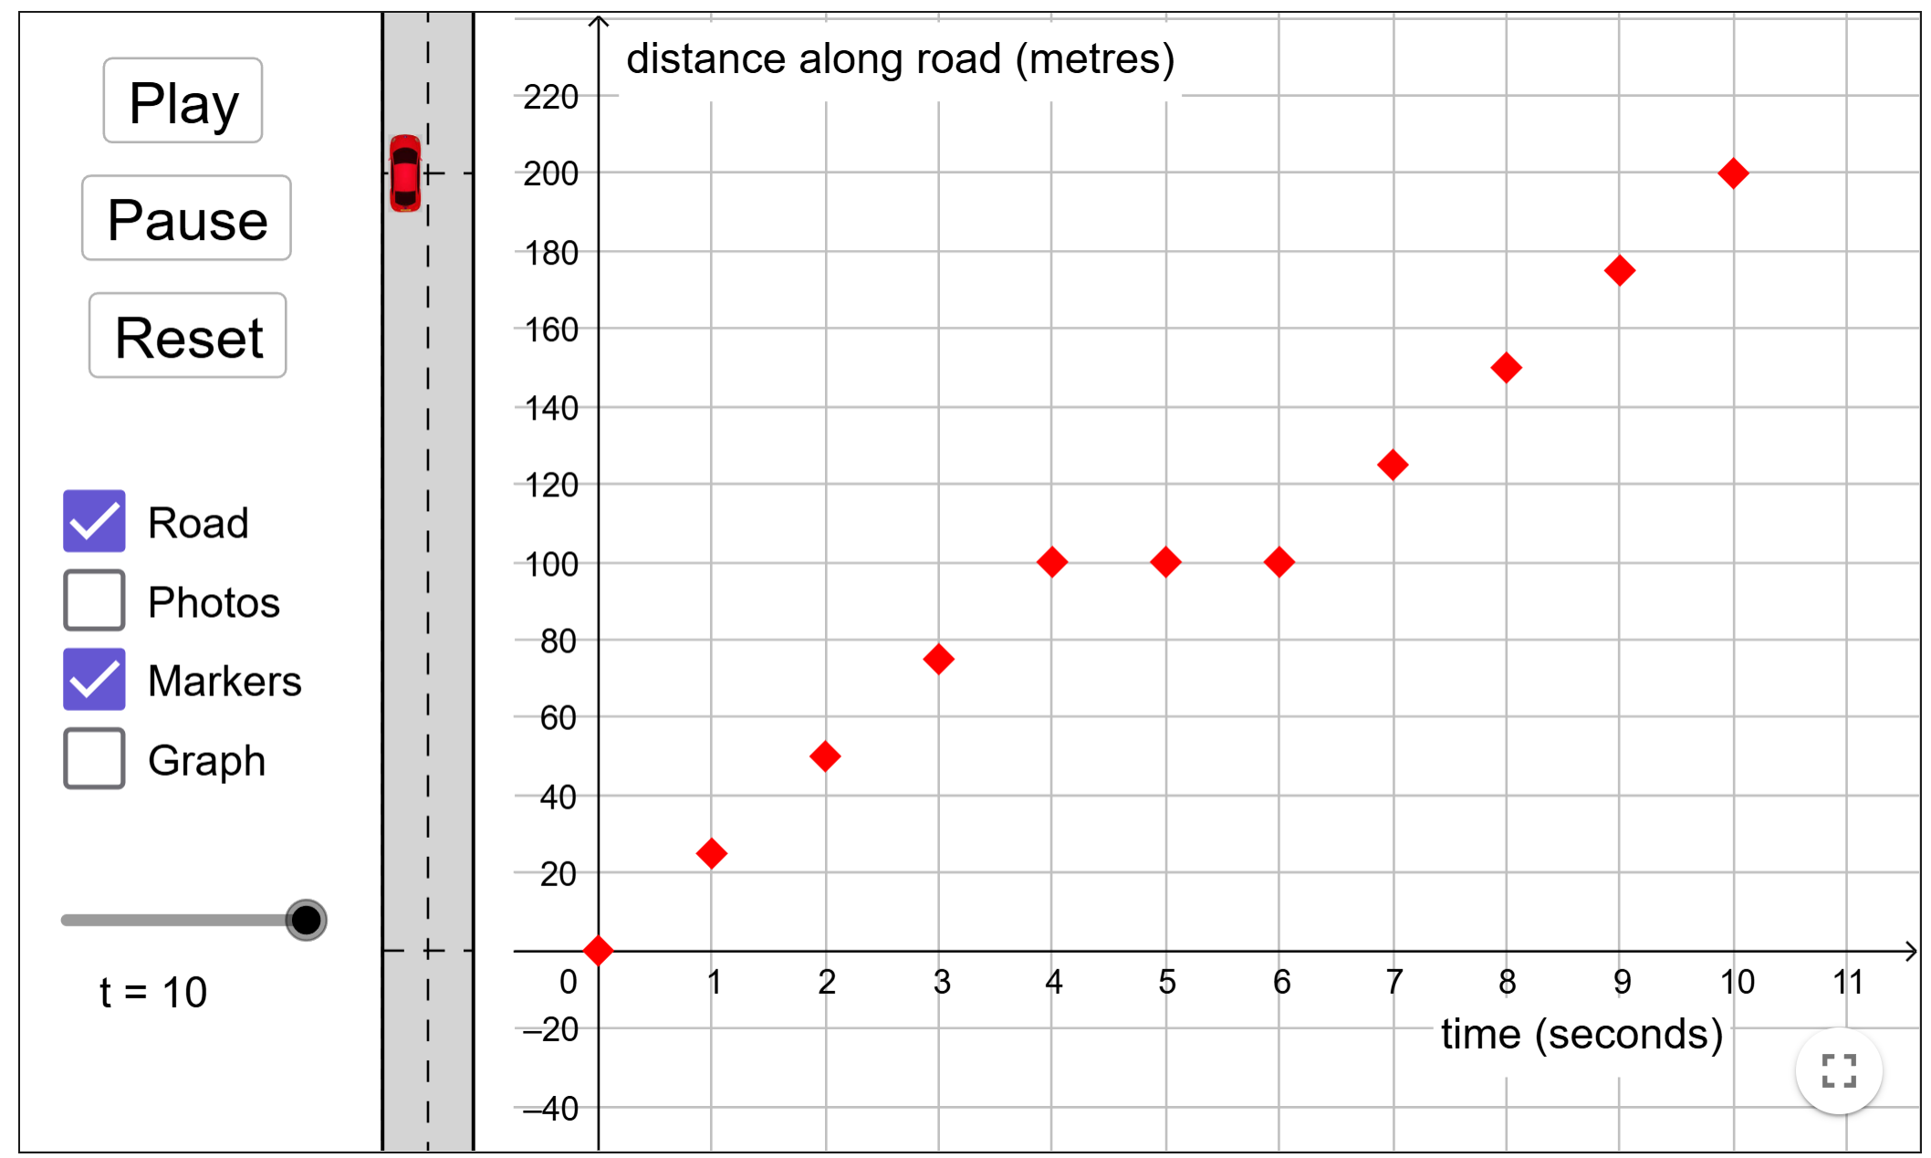

Slide 12
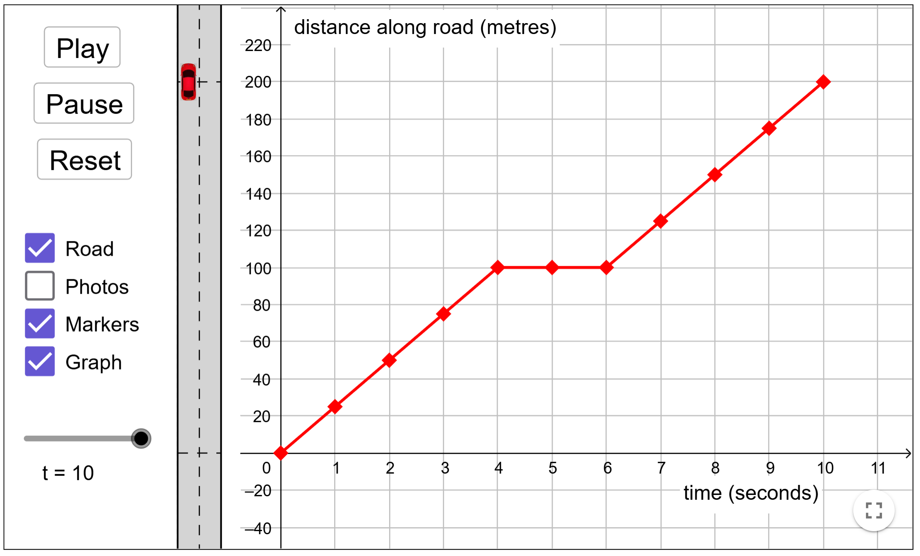

Slide 13
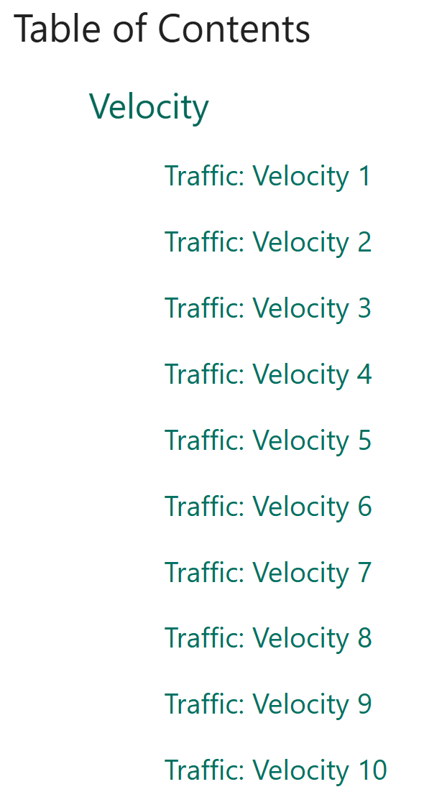
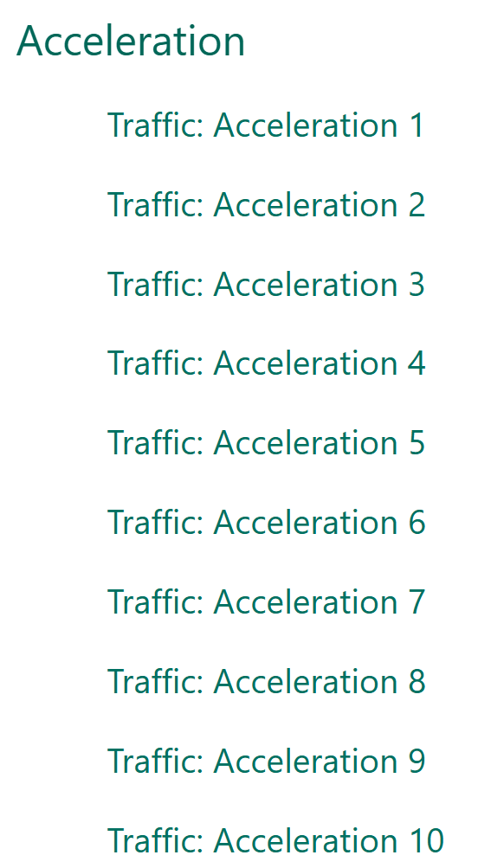

Slide 14
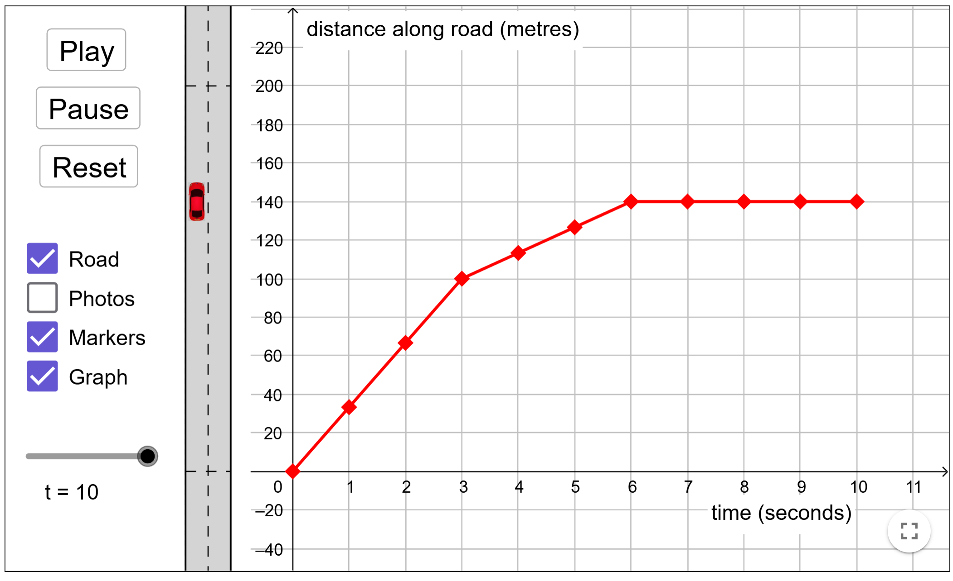
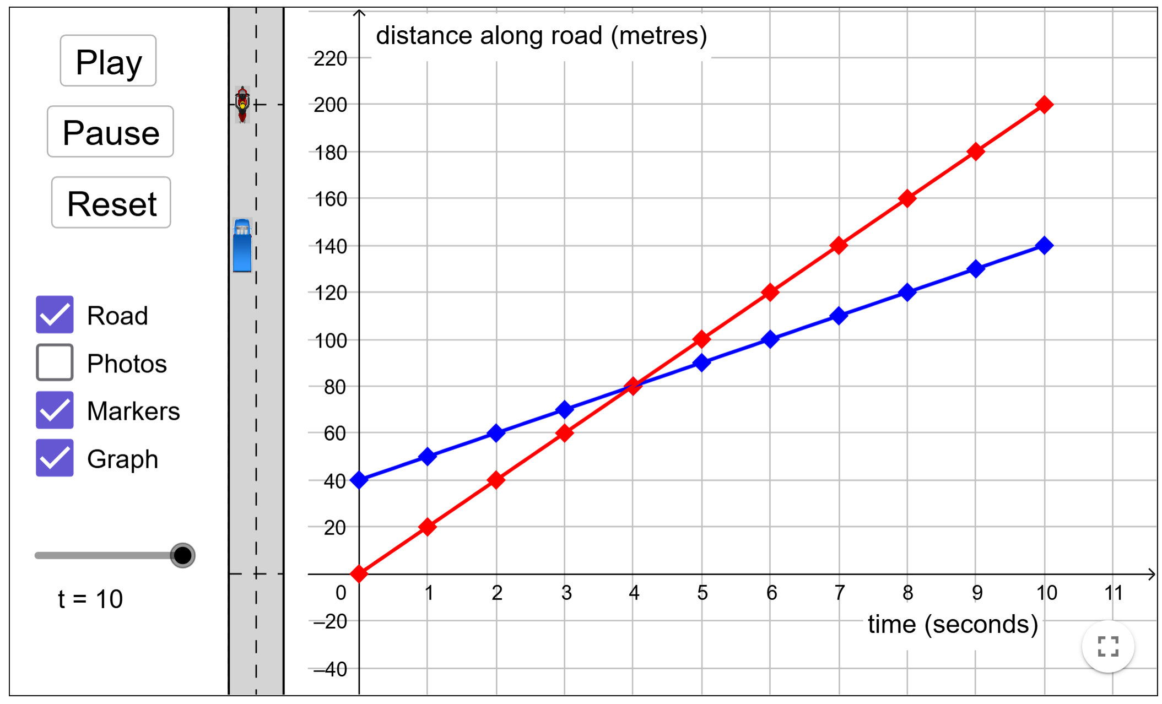
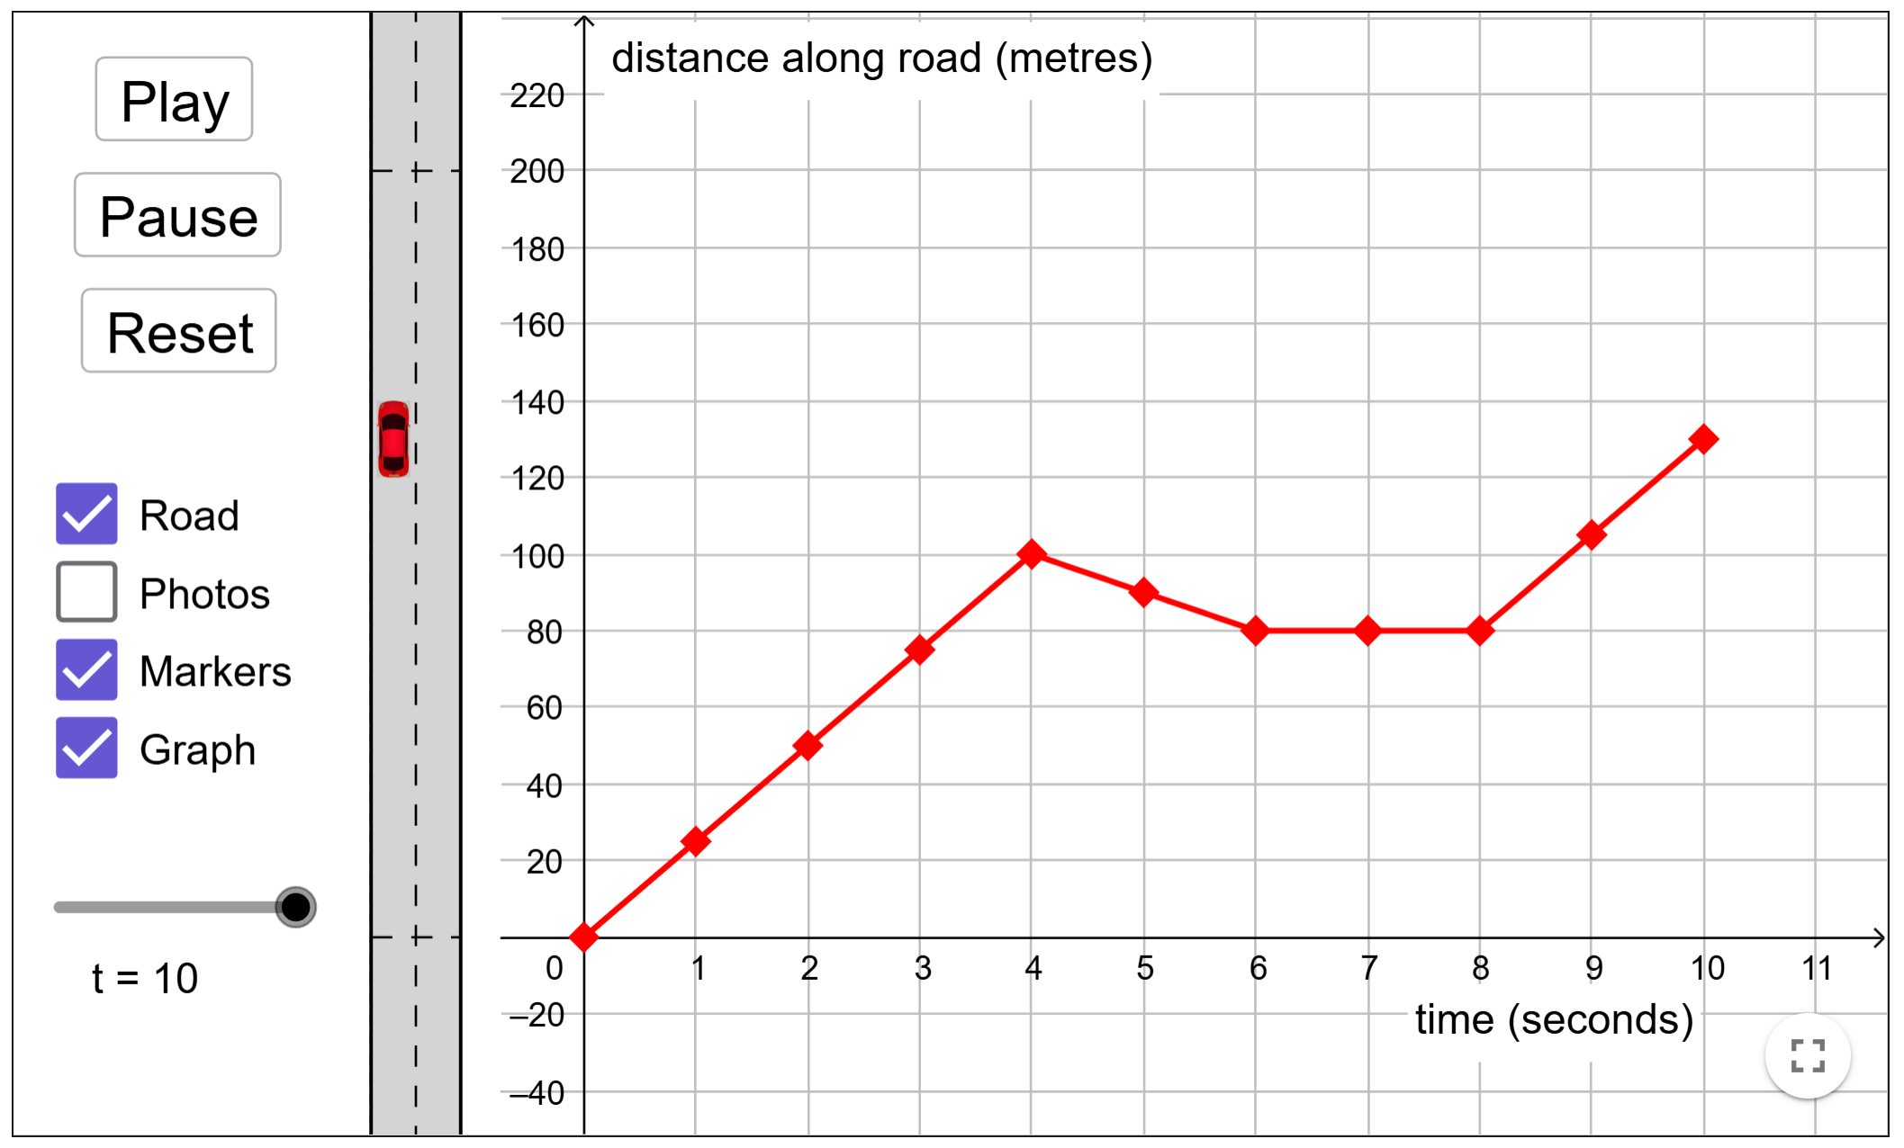
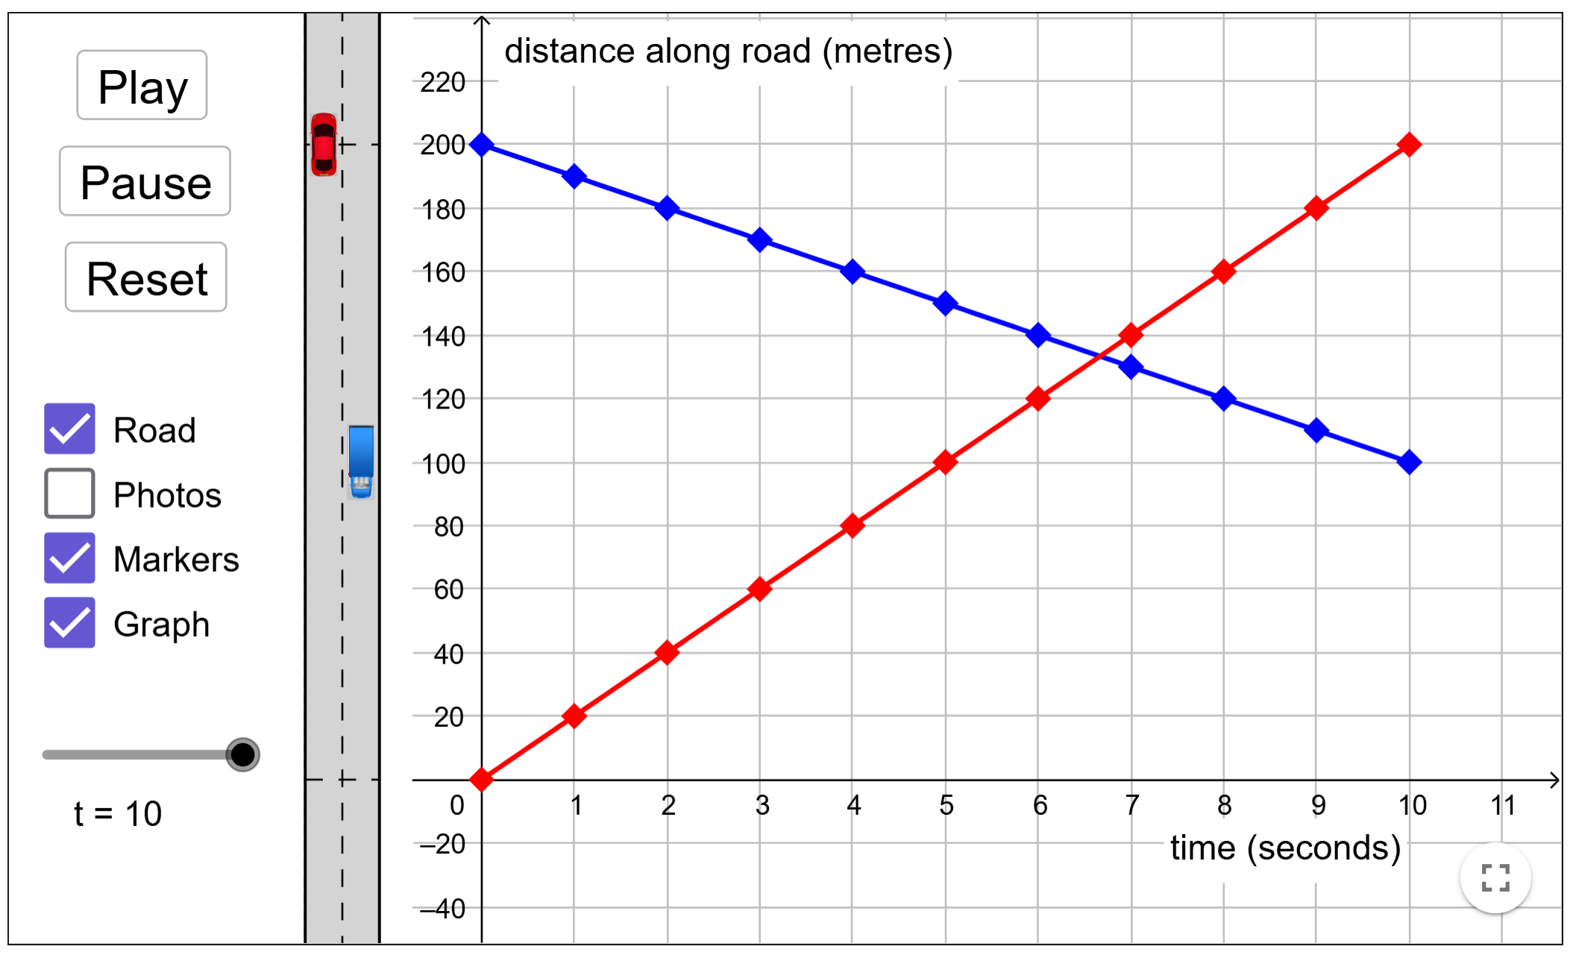
V2
V3
V4
V5

Slide 15
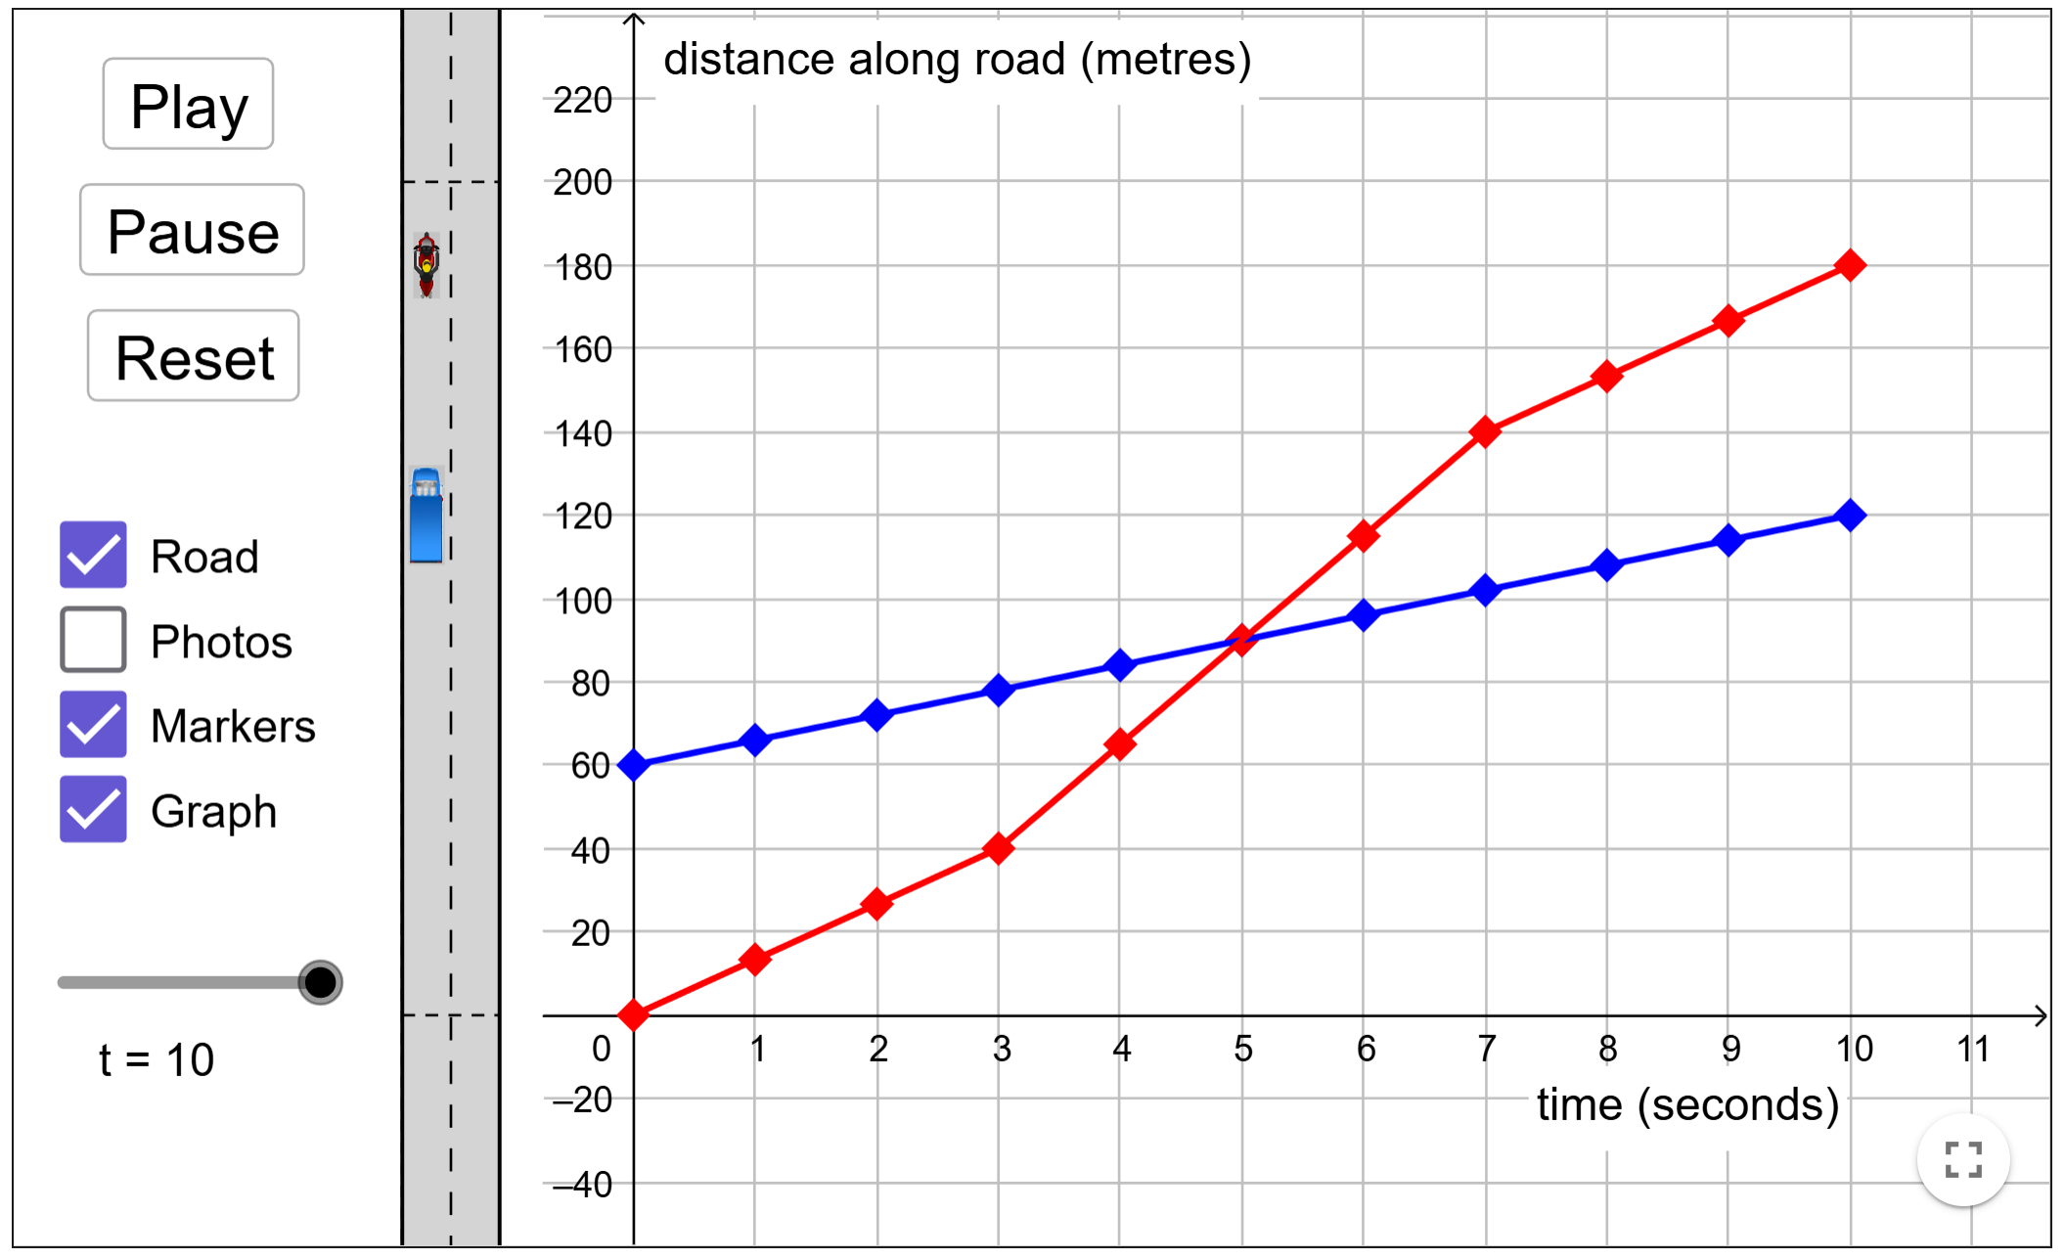
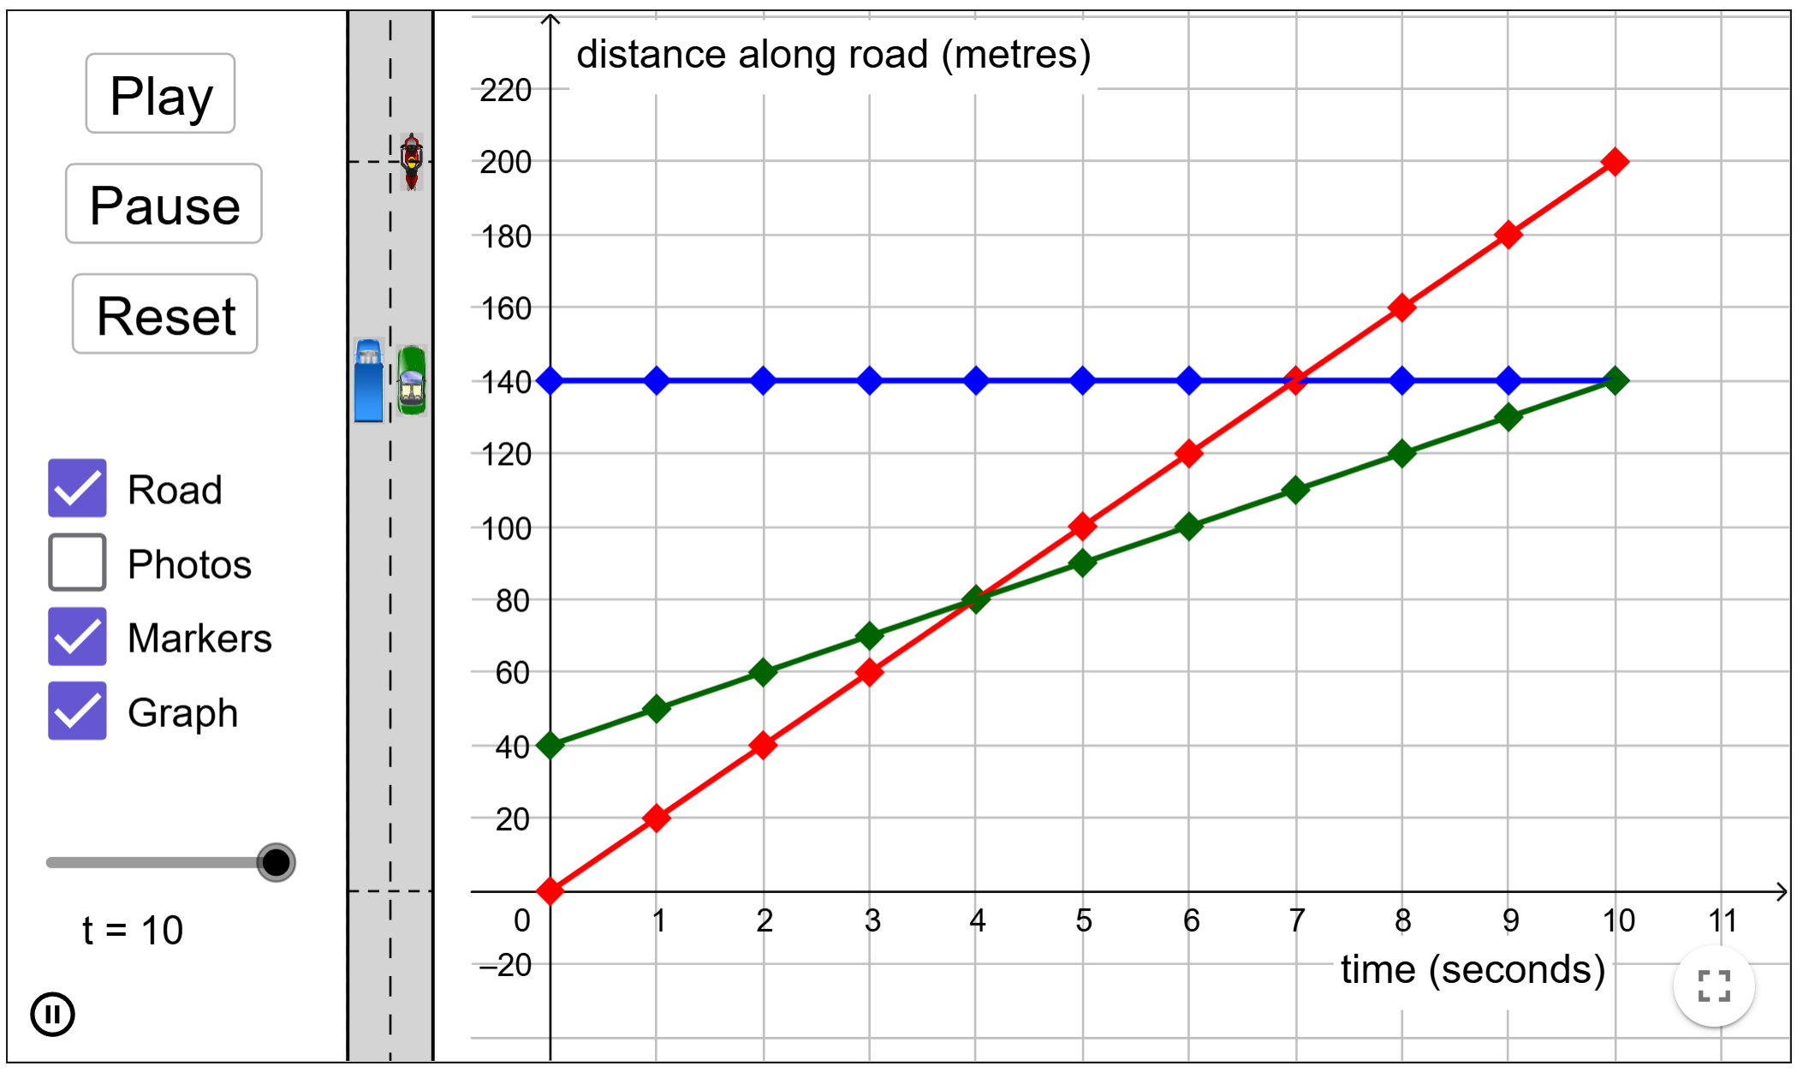
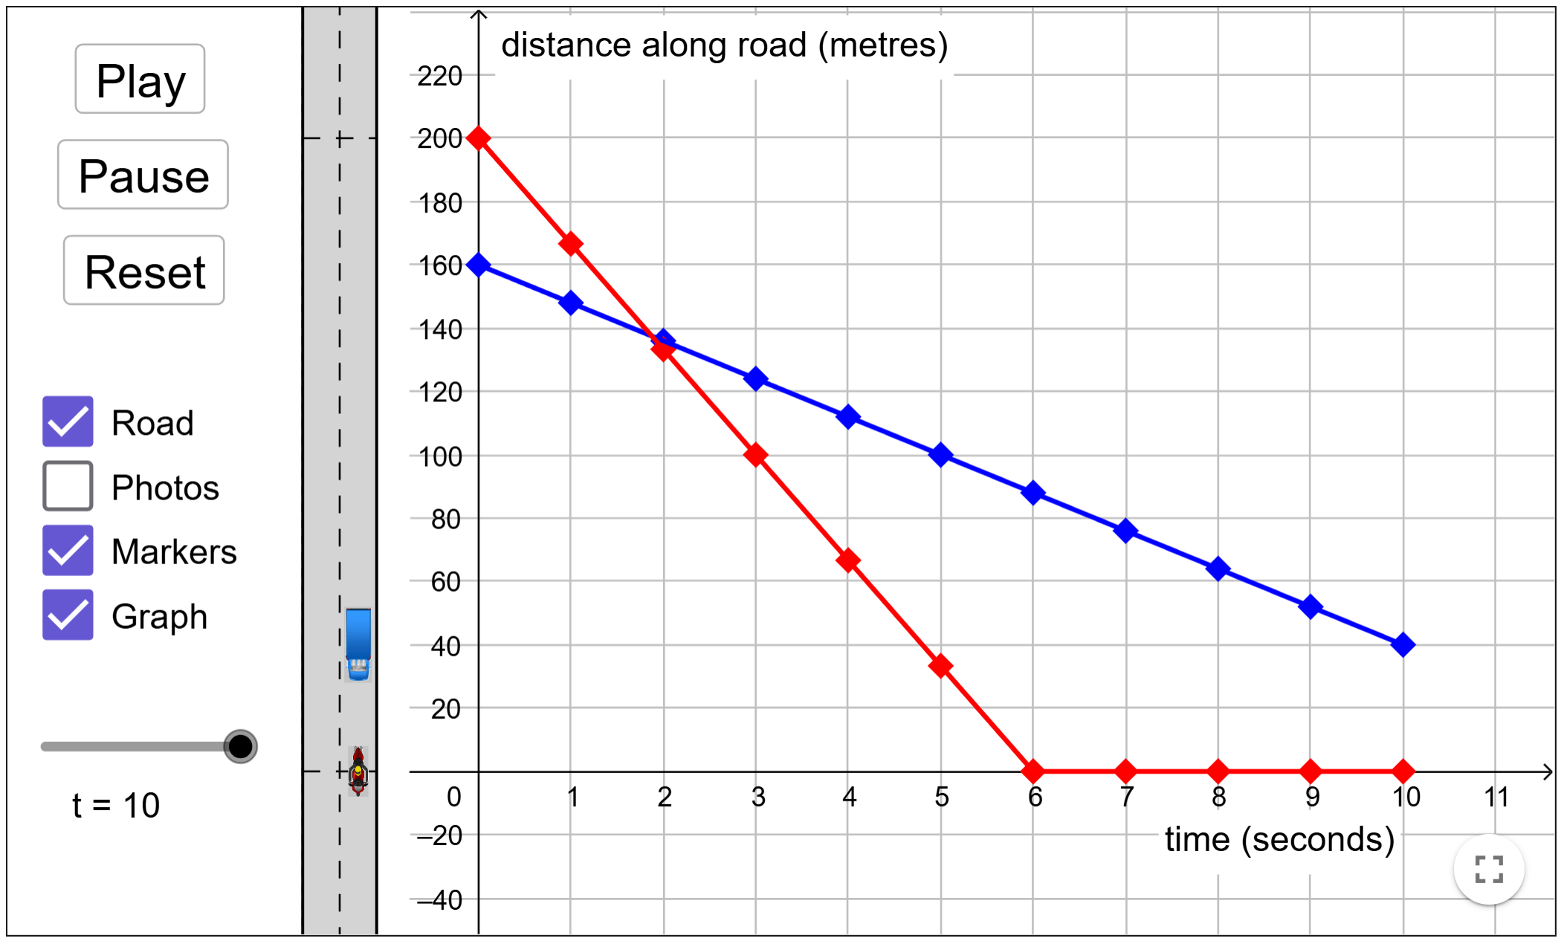
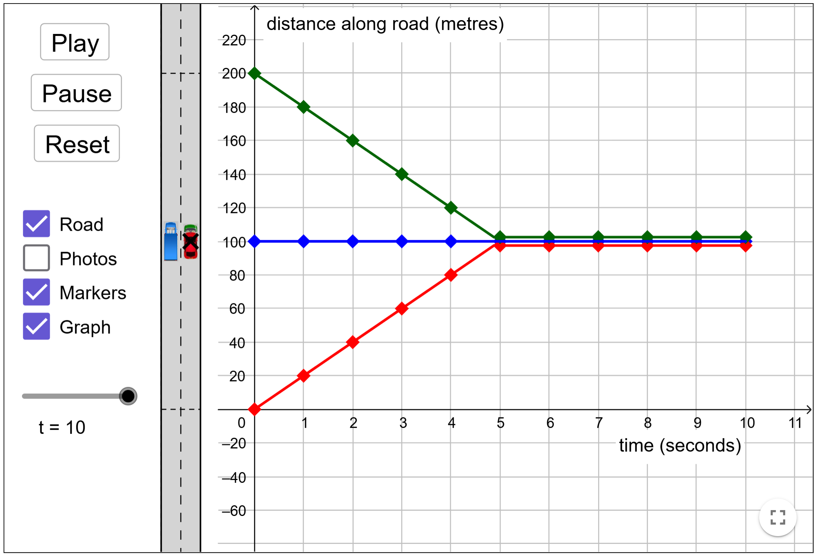
V6
V7
V8
V9

Slide 16
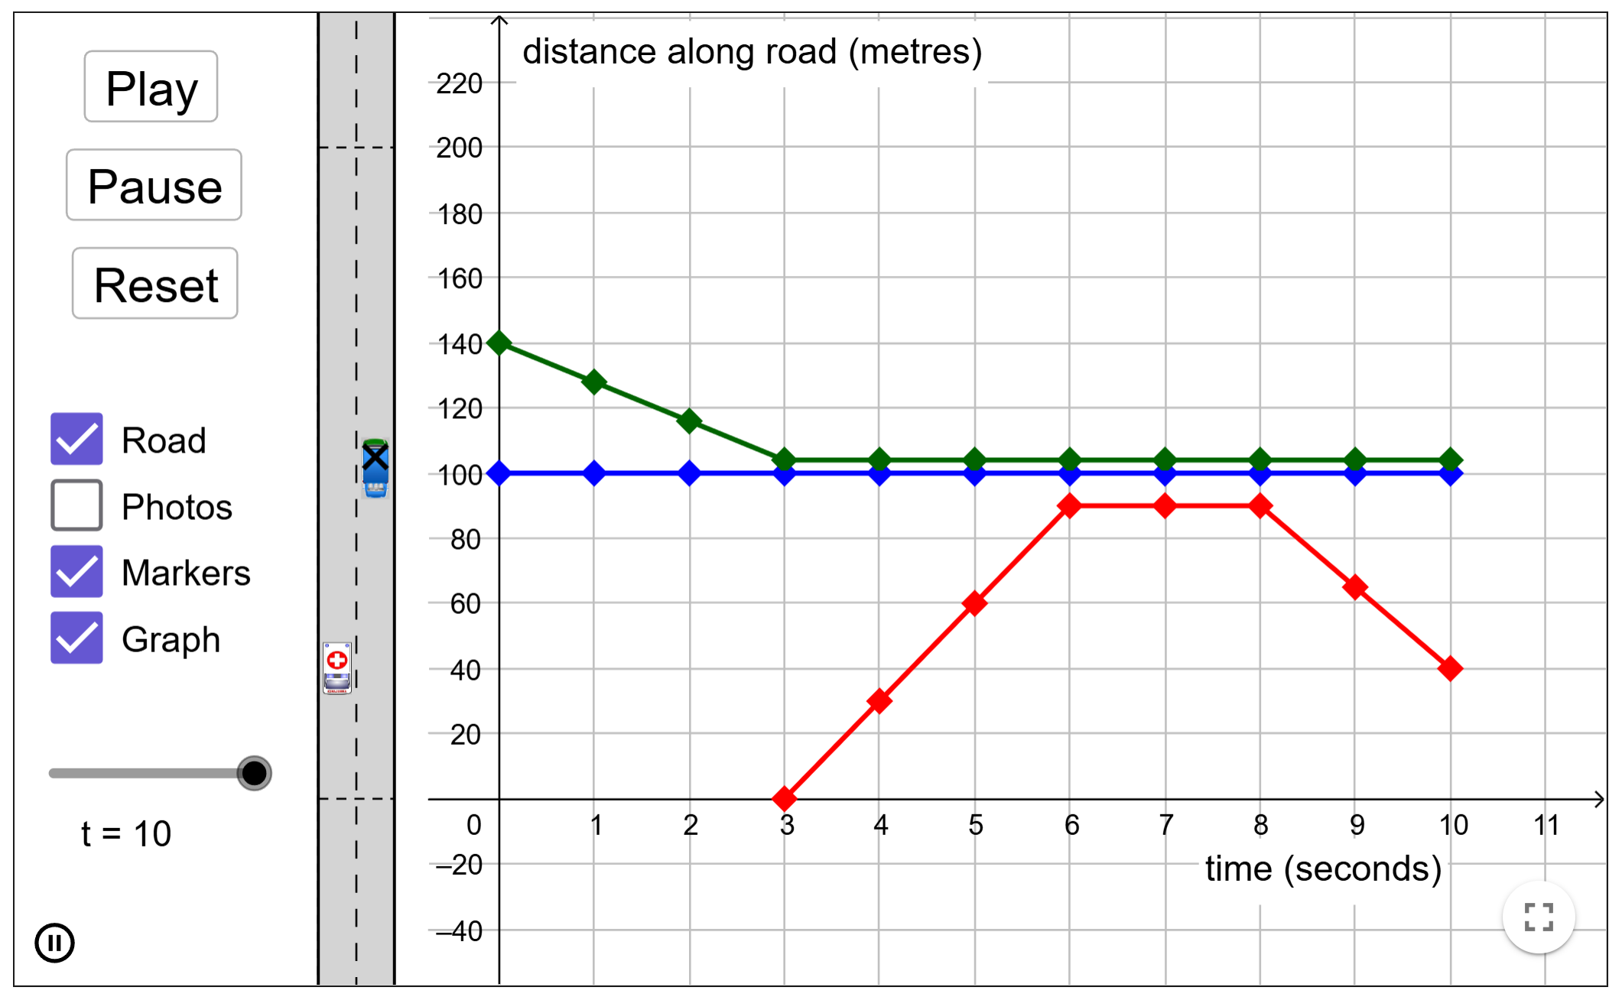
V10

Slide 17
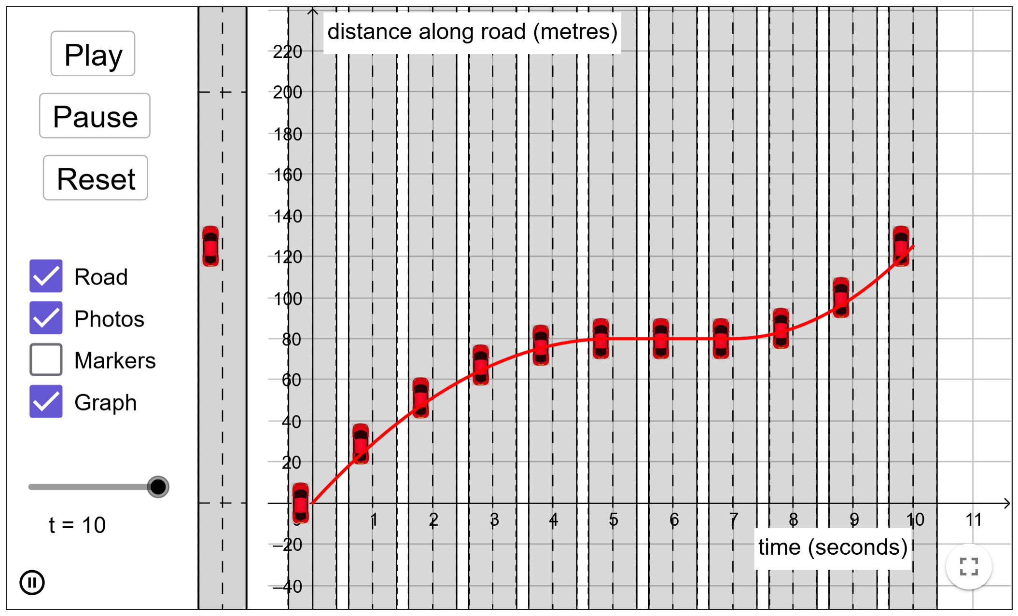
A1

Slide 18
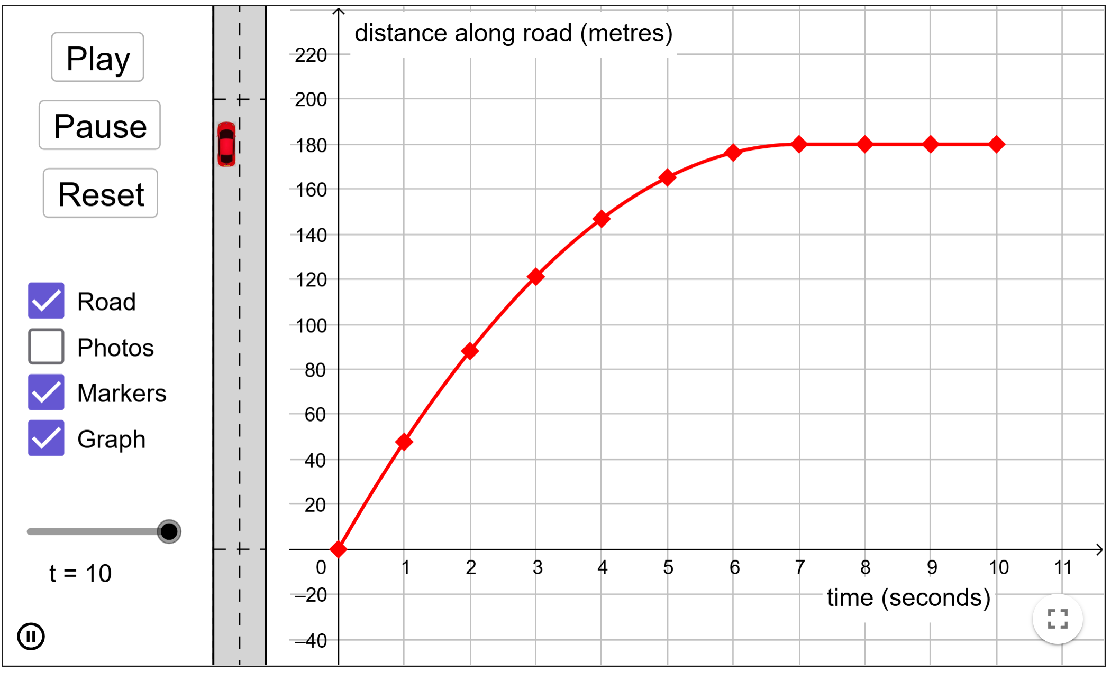
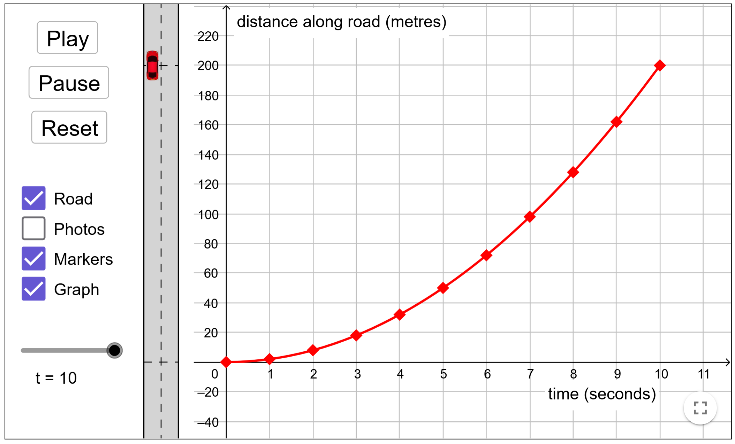
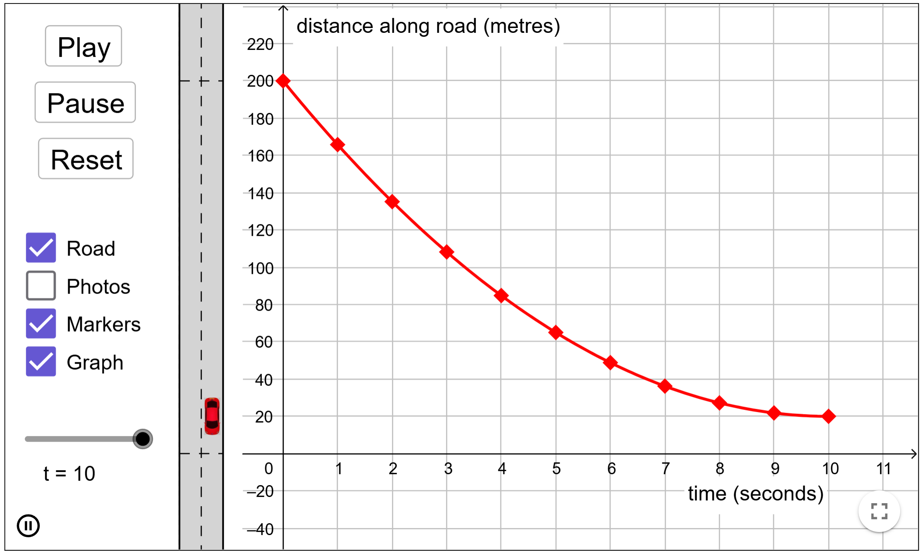
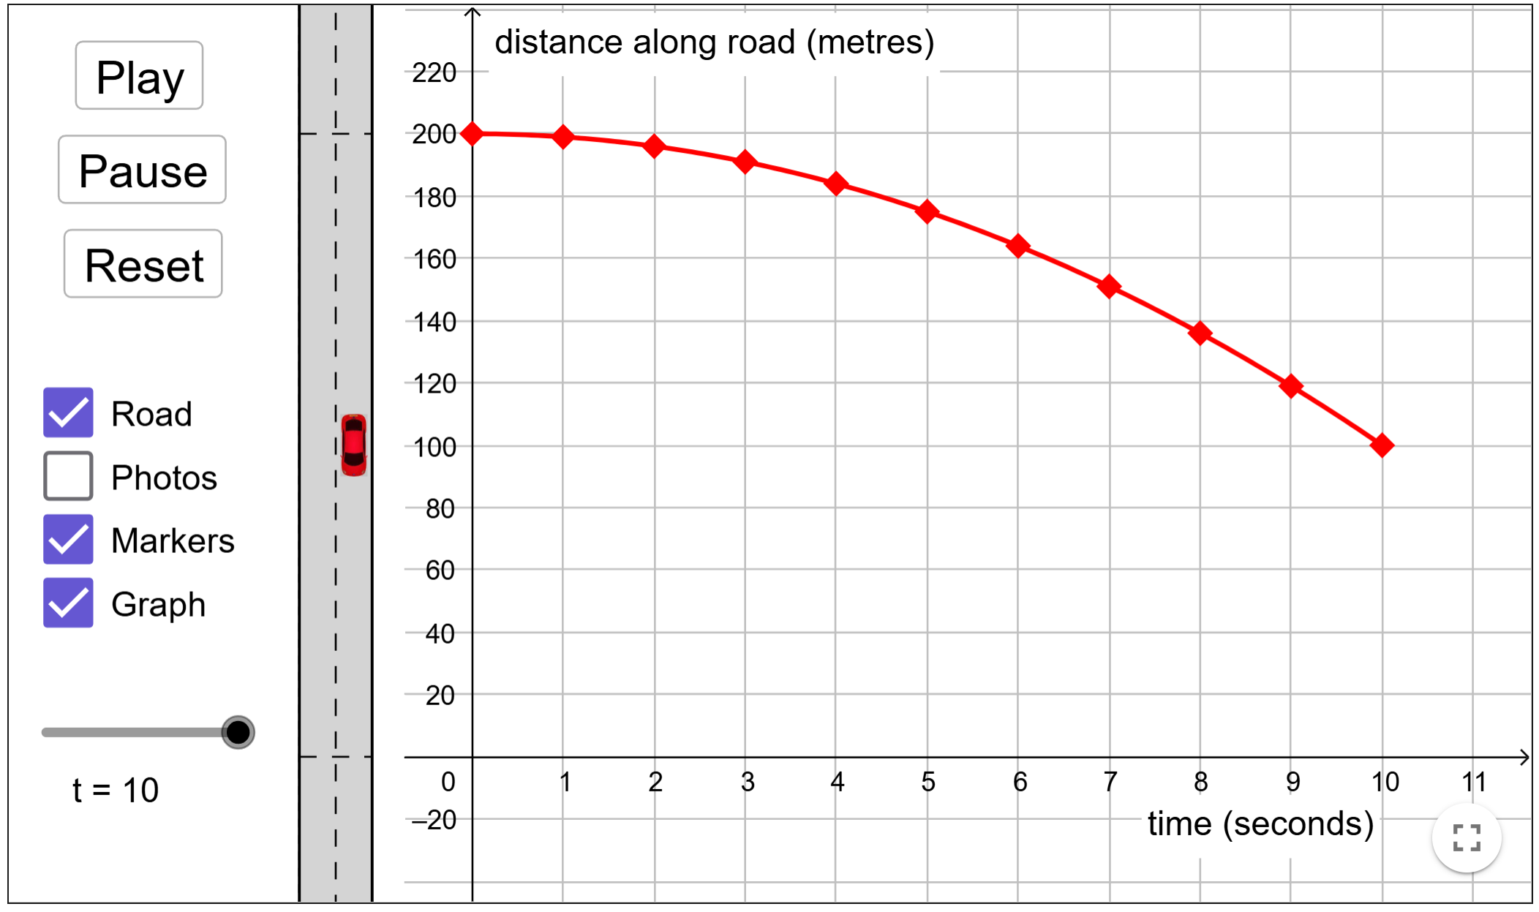
A2
A3
A4
A5

Slide 19
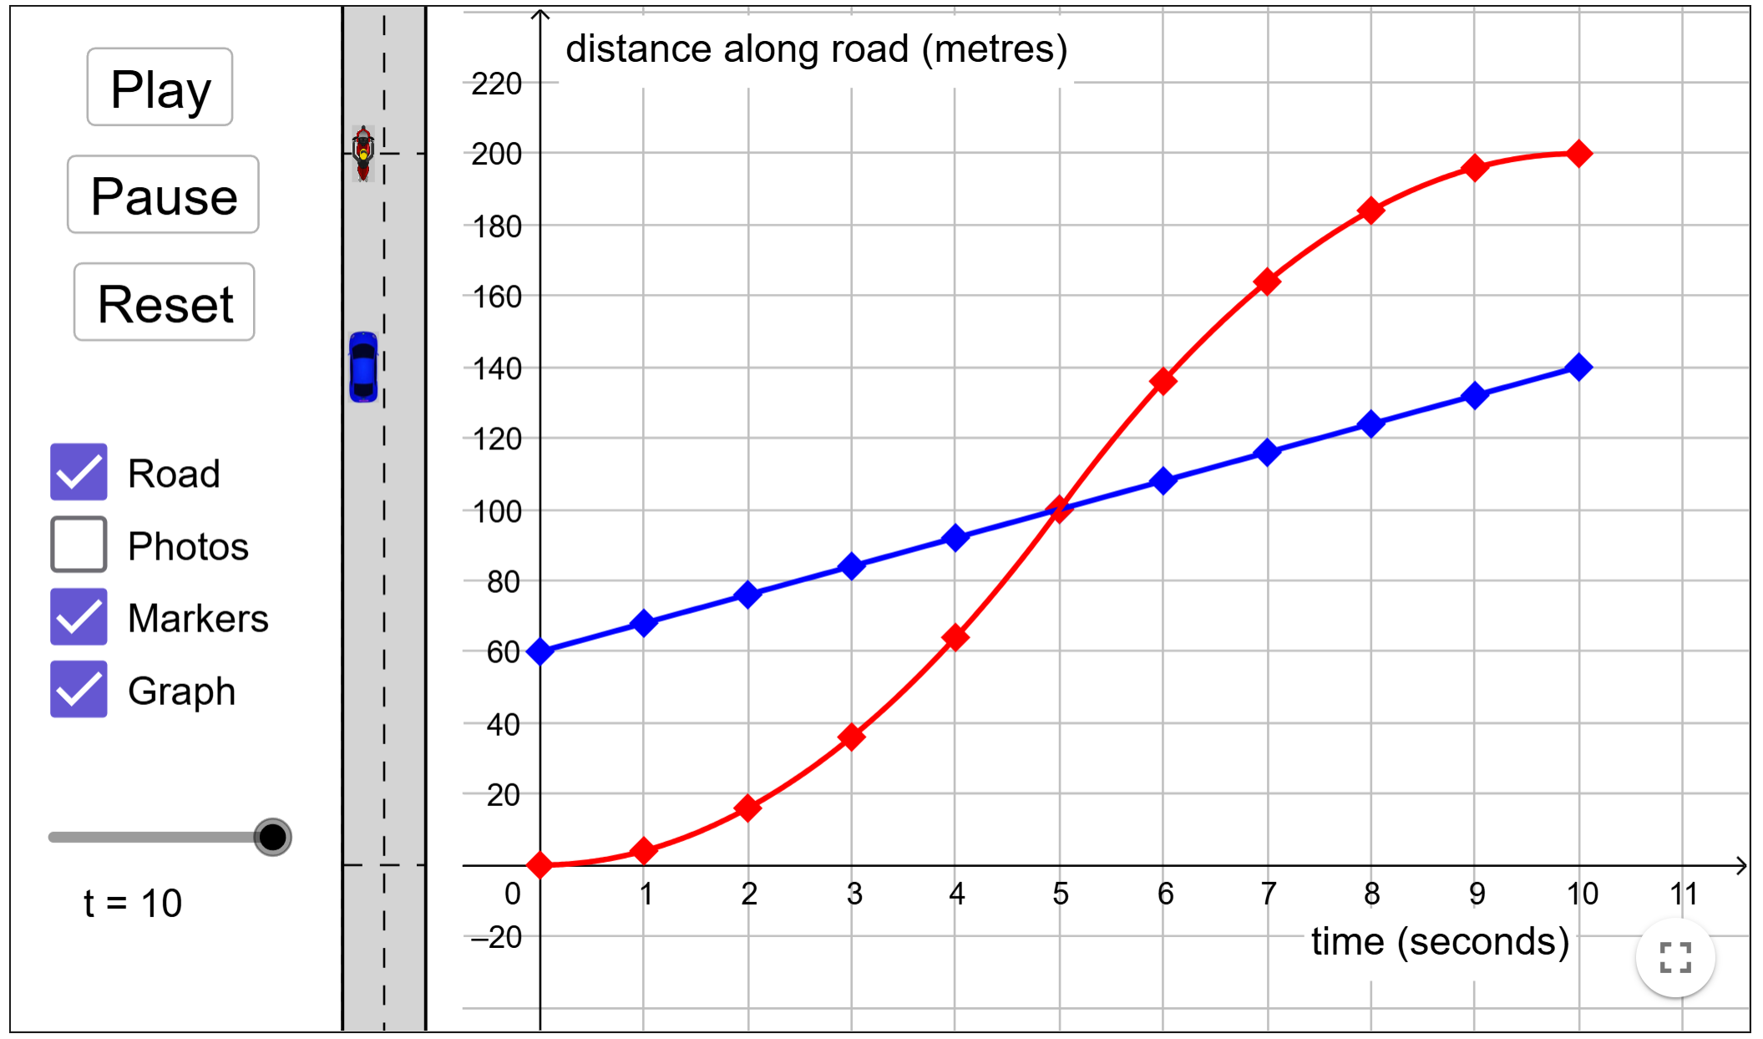
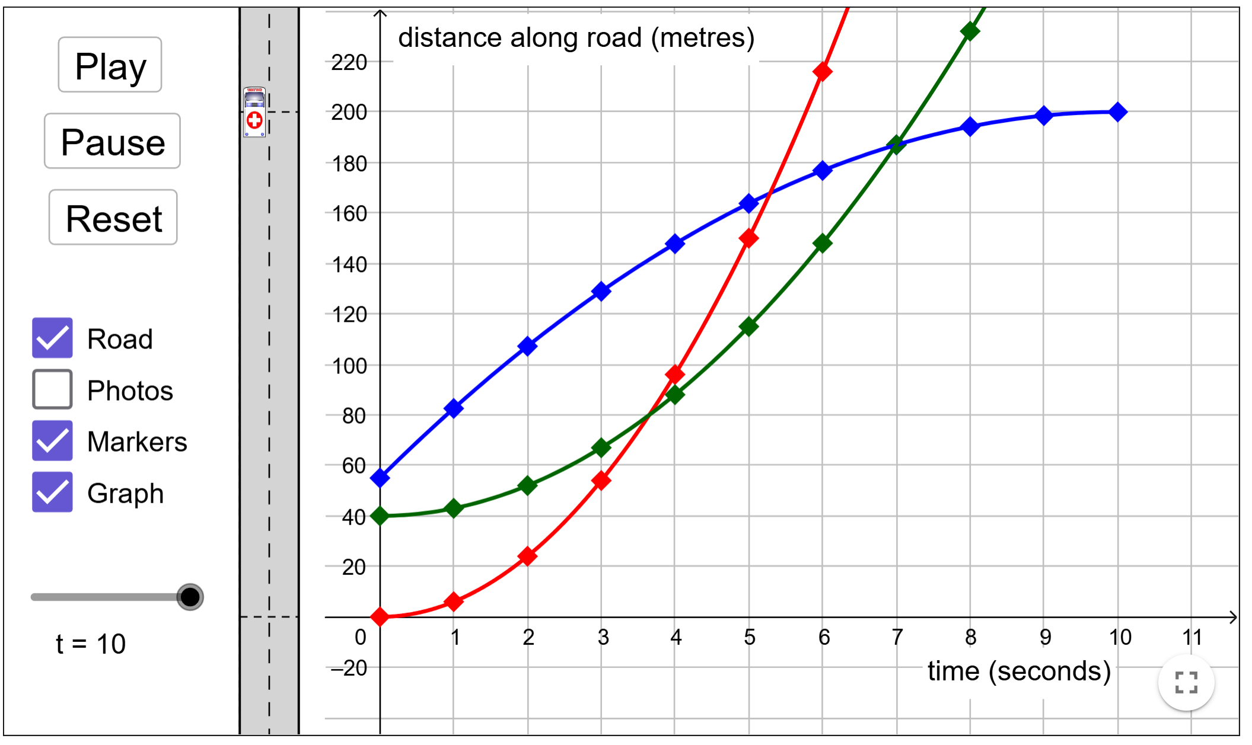
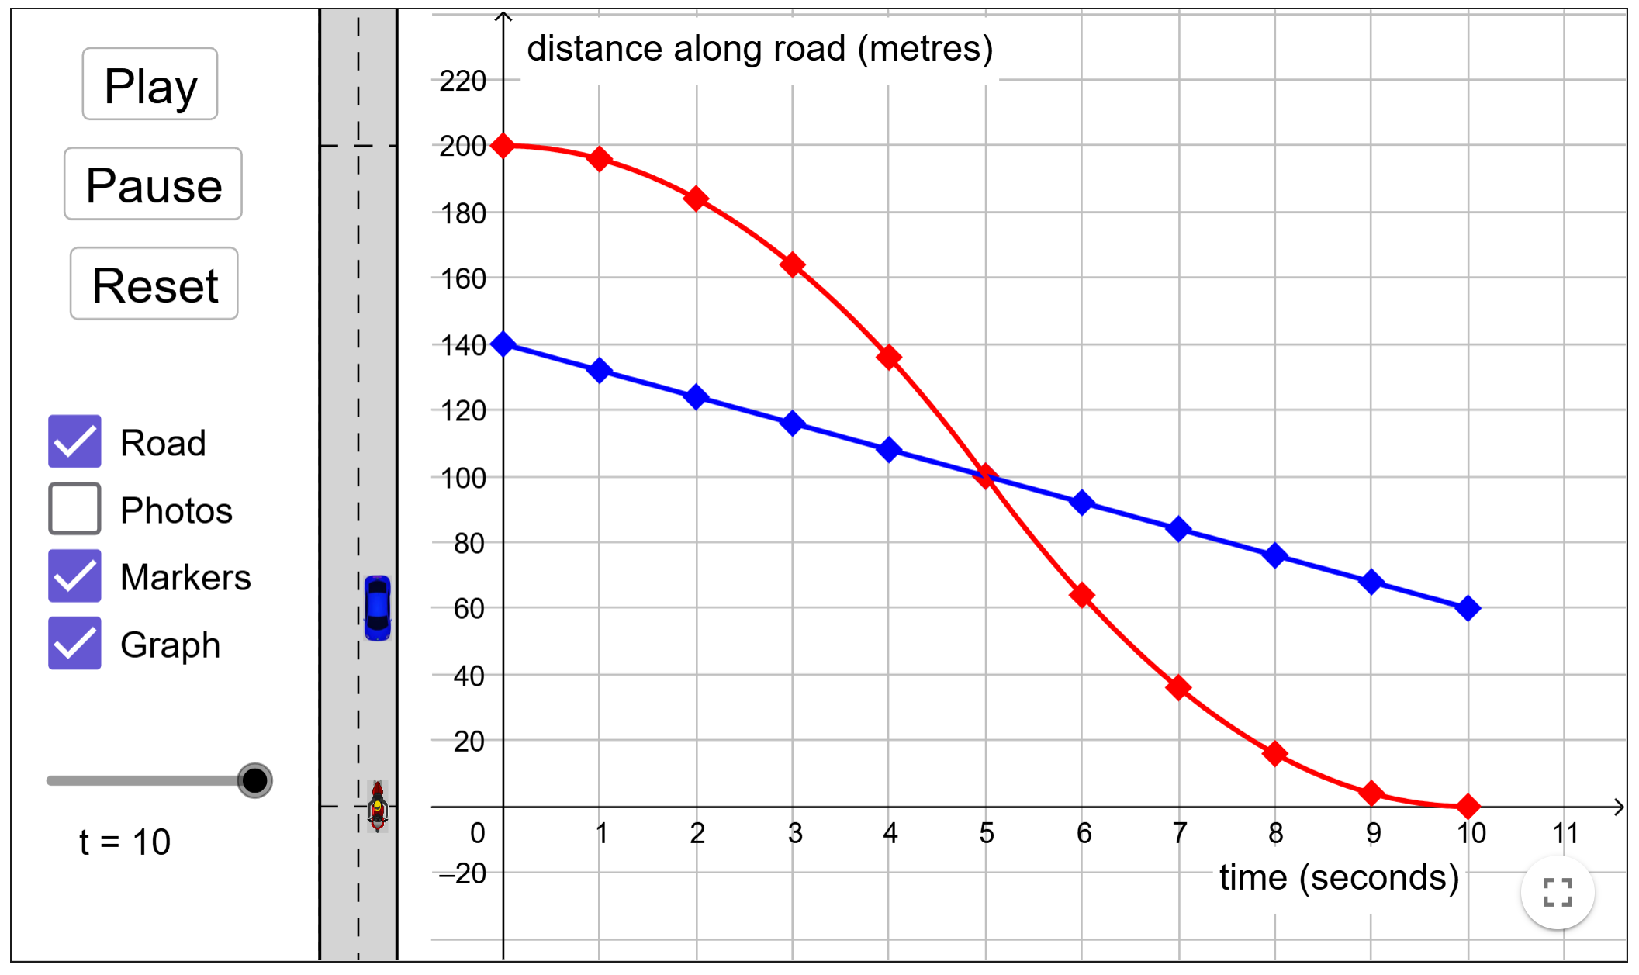
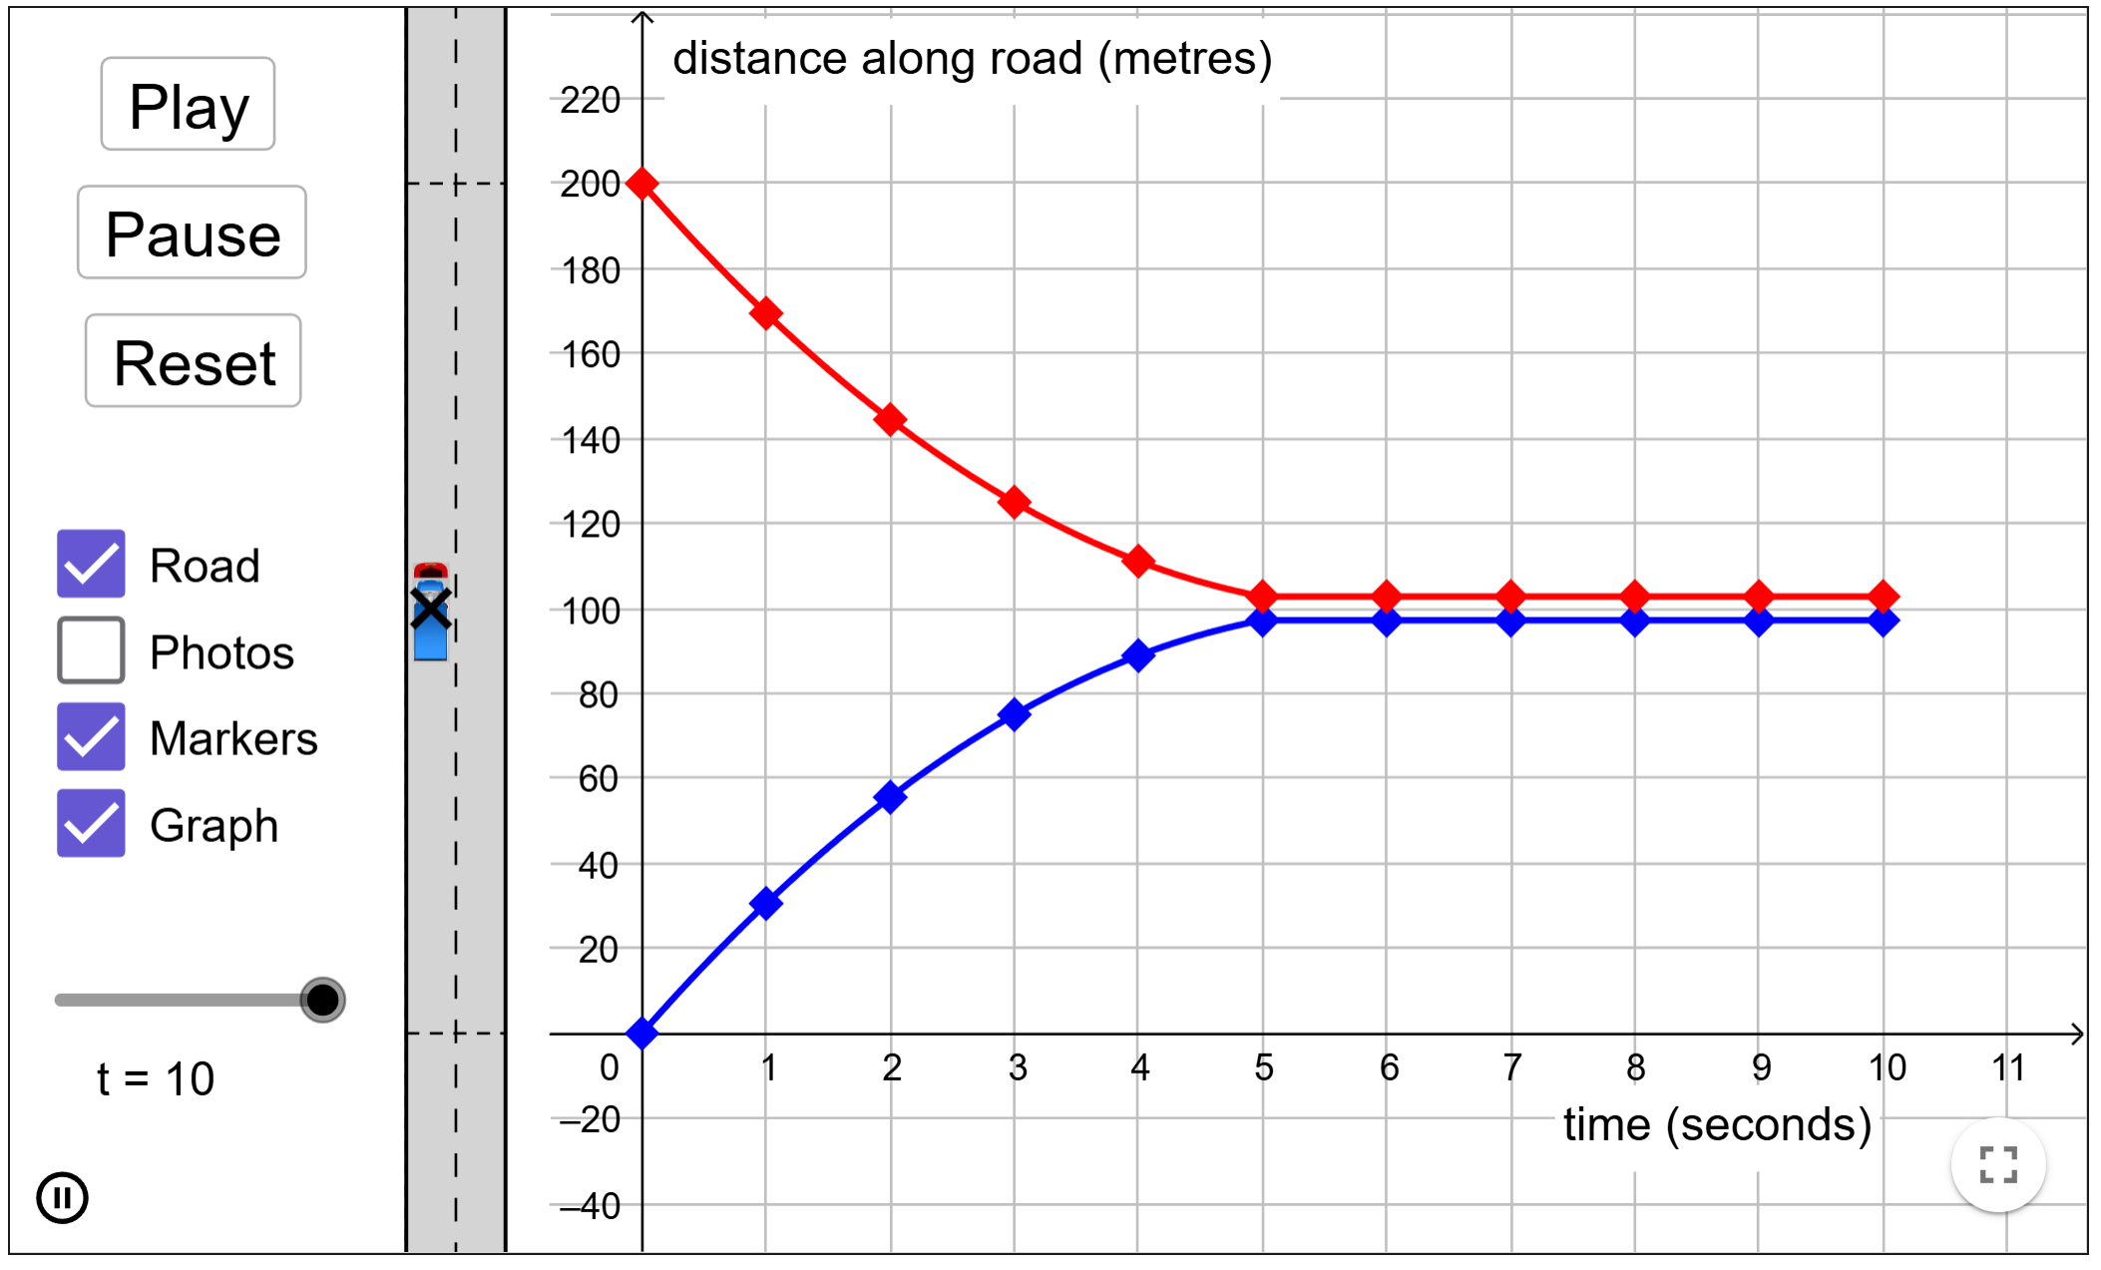
A6
A7
A8
A9

Slide 20
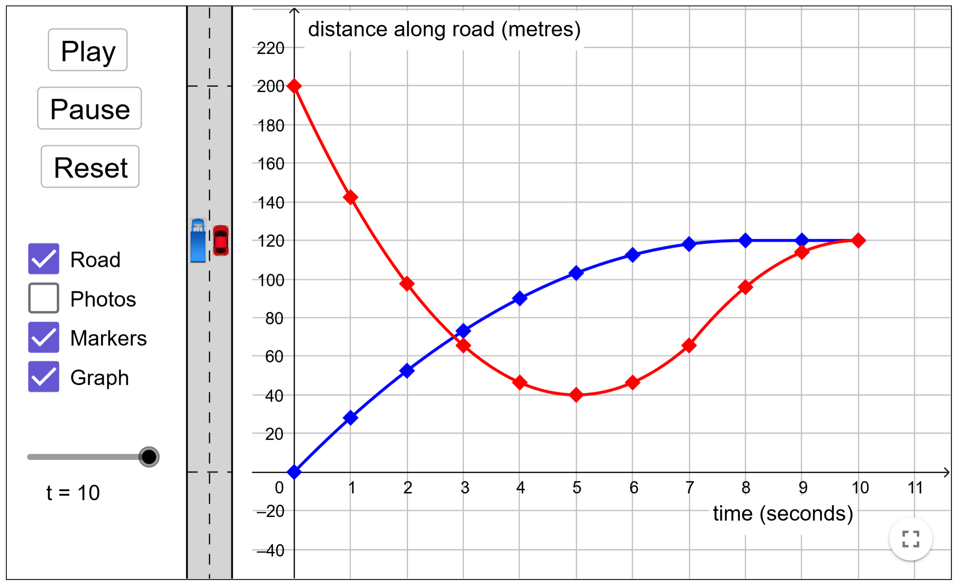
A10

Slide 21
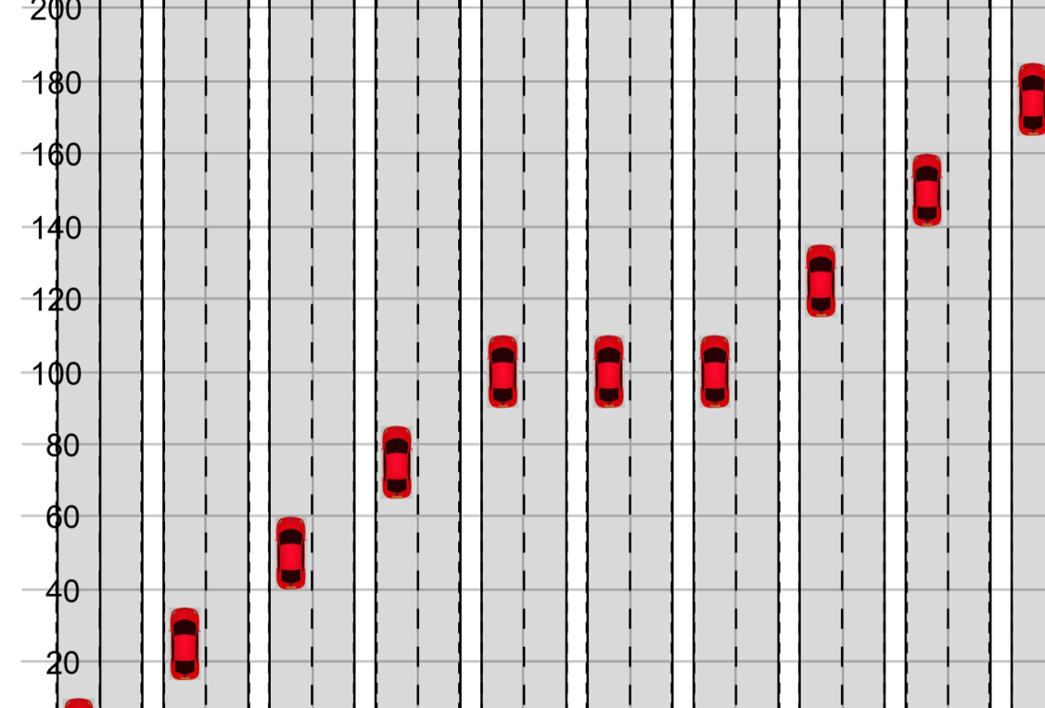
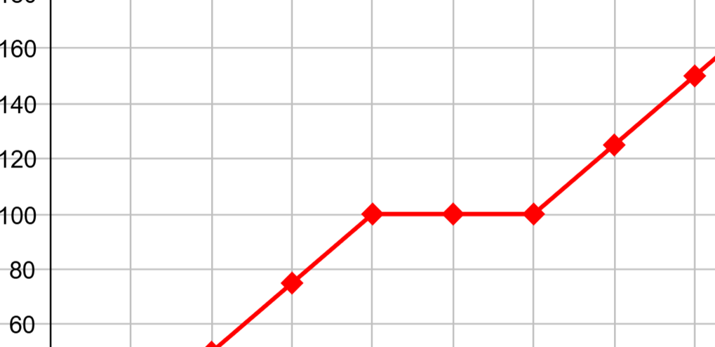
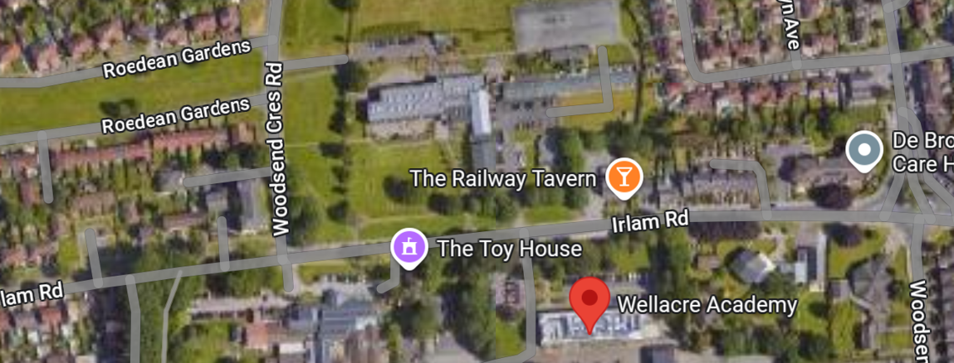
The focus of the lesson
Concrete → Pictorial → Abstract
Understand distance time graph
Address misconception (Return Journey)
Predict a graph/ describe a graph

Slide 22
Impact of the lesson
Reflection
Next Steps

Slide 23
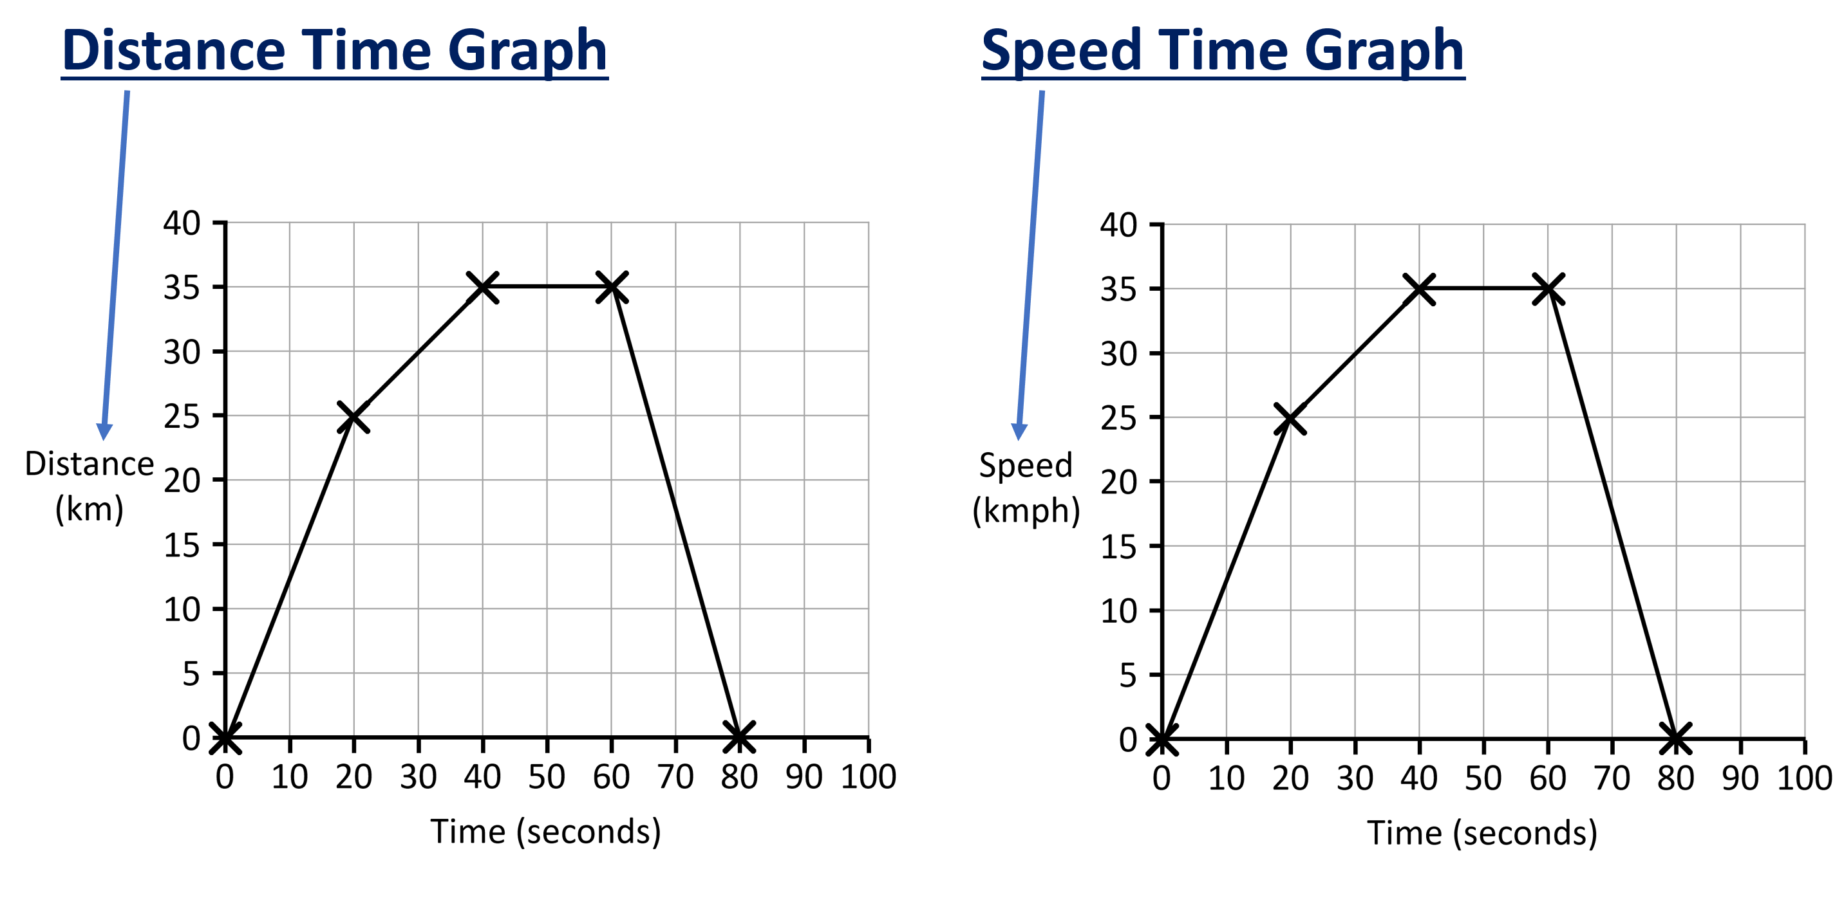

Slide 24
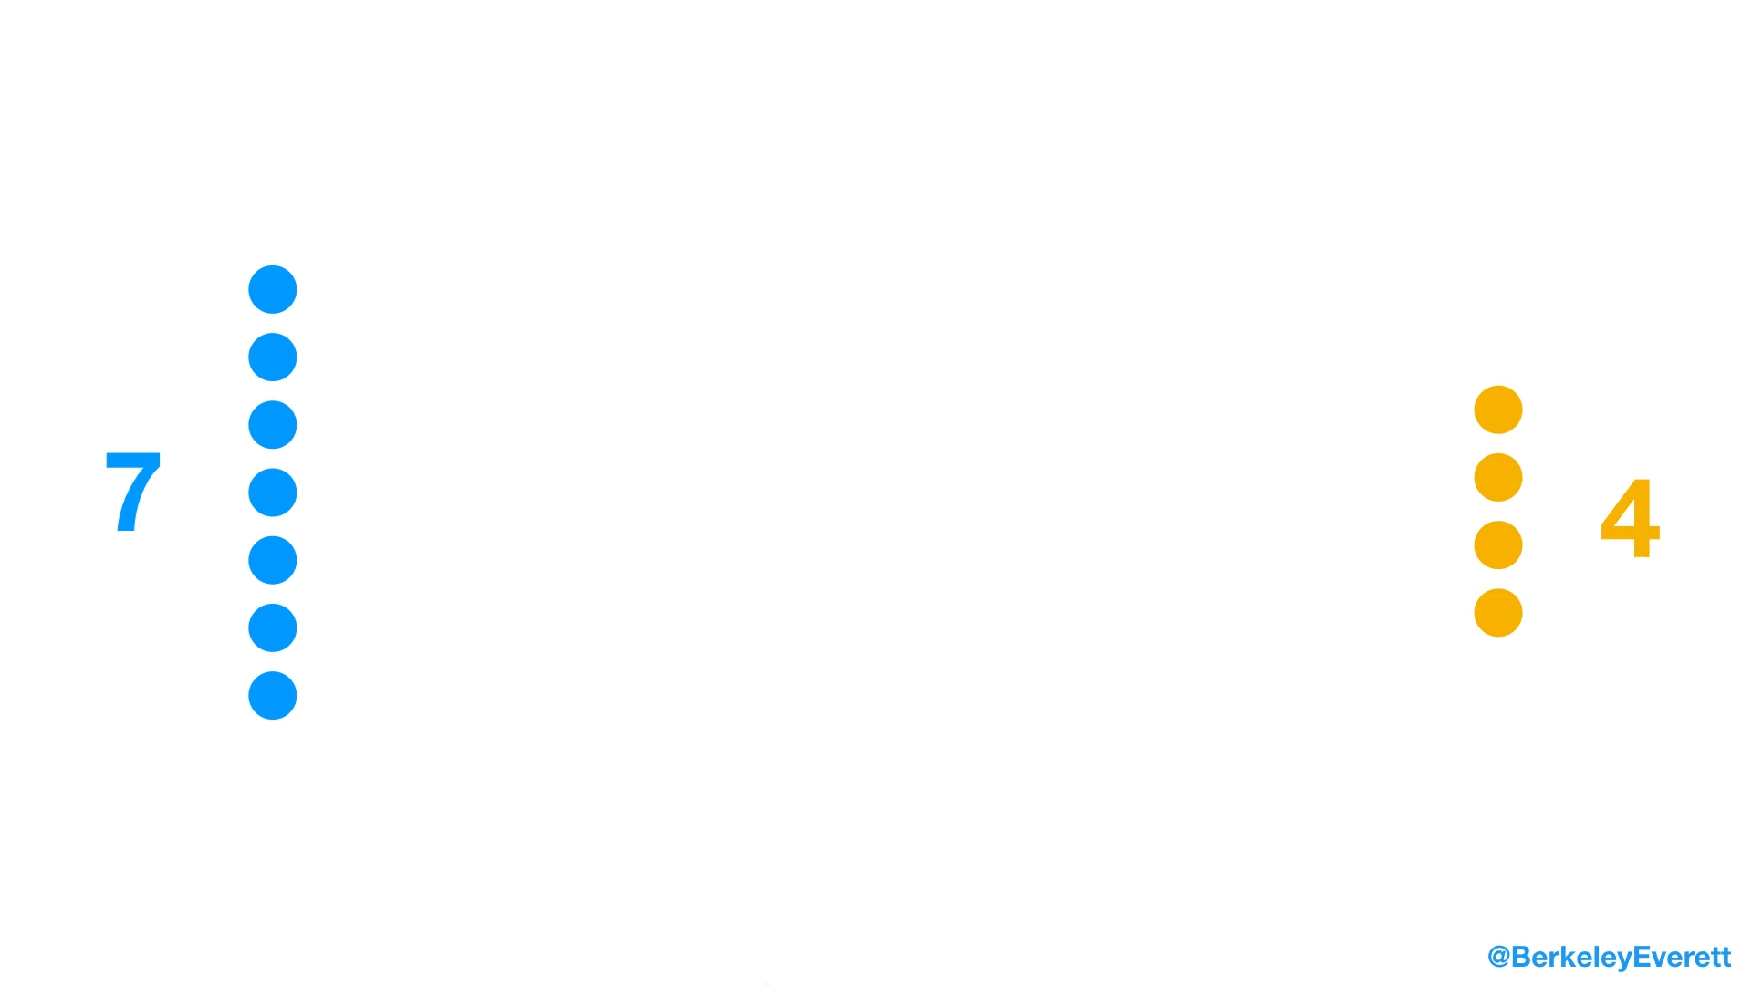
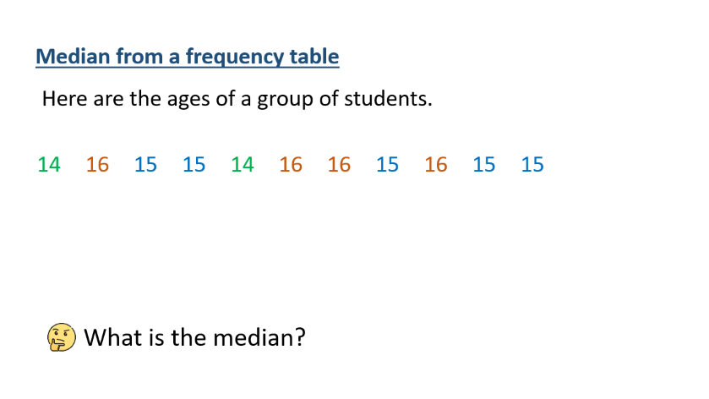
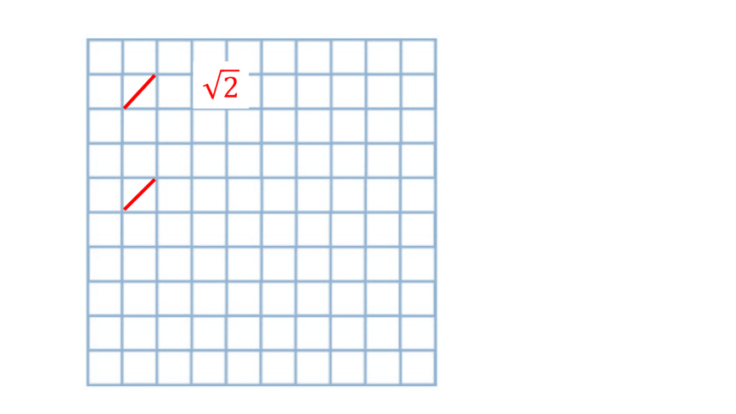
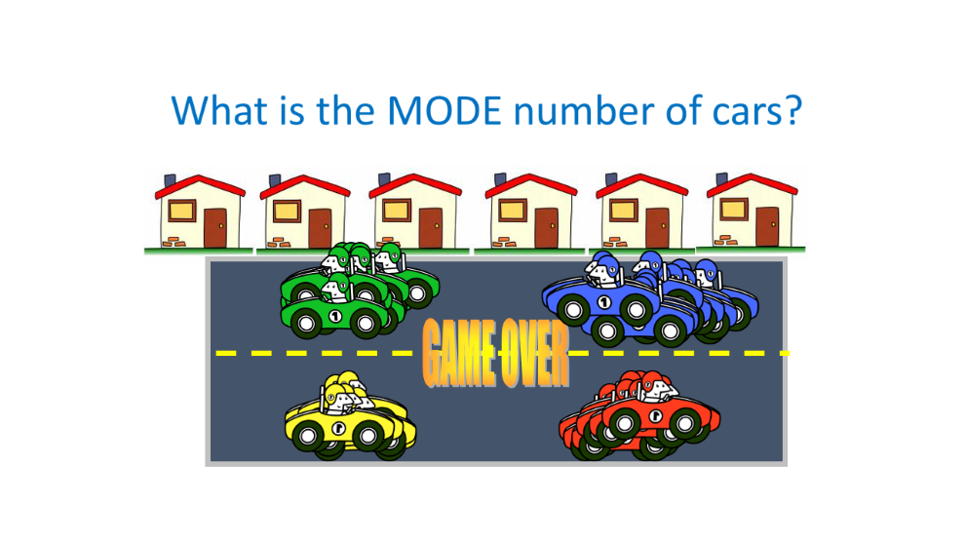
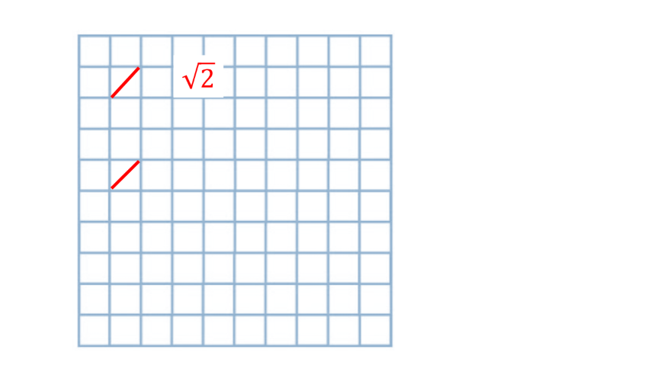
Representation – Visual aid

Slide 25





GAME OVER

Slide 26
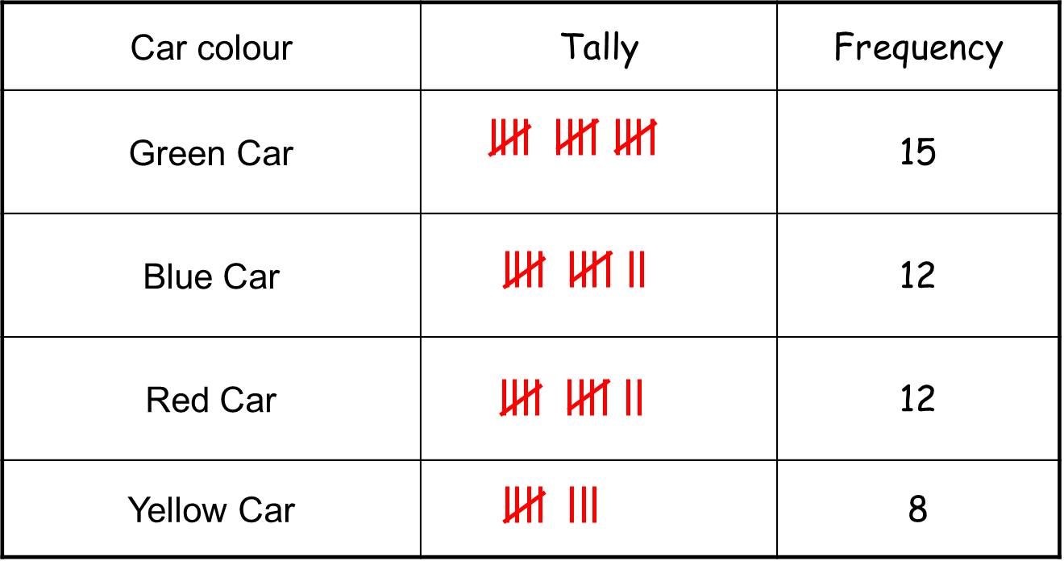

Slide 27

What is the mode?

Slide 28

Median from a frequency table
Here are the ages of a group of students.
14
16
15
15
14
16
16
15
16
15
15
What is the median?

Slide 29
Median from a frequency table
Here are the ages of a group of students.
14
14
15
15
15
15
15
16
16
16
16
What is the median?

Slide 30
Median from a frequency table
Here are the ages of a group of students.
14
14
15
15
15
15
15
16
16
16
16
Age | Frequency
What is the median?

Slide 31
Median from a frequency table
Here are the ages of a group of students.
Age | Frequency
14
14
15
15
15
15
15
16
16
16
16
What is the median?

Slide 32
Median from a frequency table
Here are the ages of a group of students.
Age | Frequency
 | 2
 | 5
 | 4
14
14
15
15
15
15
15
16
16
16
16
What is the median?

Slide 33
Median from a frequency table
Here are the ages of a group of students.
Age | Frequency
14
14
15
15
15
15
15
16
16
16
16
What is the median?

Slide 34
Median from a frequency table
Here are the ages of a group of students.
14
14
15
15
15
15
15
16
16
16
16
Age | Frequency
What is the median?

Slide 35
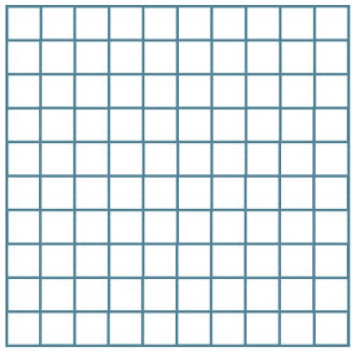

$$\sqrt{2}$$

Slide 36

$$\sqrt{2}$$
$$2\sqrt{2}$$
?

Slide 39


$$\sqrt{2}$$
$$\sqrt{3}$$

Slide 40
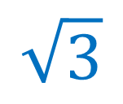
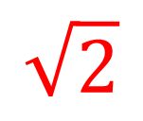
$$\sqrt{3}$$
$$\sqrt{2}$$

